Slide 1
Code generation and Version Control

Slide 2
Code Generation
Generating the class structure can be tedious
  Instance variables
  Class relationships
  Etc
EA can generate stubbed code from UML Class diagrams!
  Demo
Code Generation Tutorial
  https://emerald.msoe.edu/resources/doku.php?id=development_tools:enterprise_architect:code_engineering

Slide 3

Version Control

Slide 4
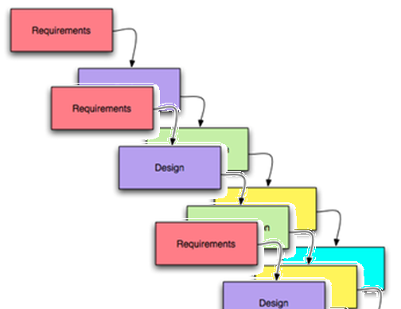
In many cases, multiple projects run concurrently
New features are typically being added to the next version
While at the same time, defects need to be corrected in existing releases

Slide 5
A team of software engineers work together toward a release
All team members work on the same code and develop their respective parts
An engineer may be responsible for an entire class
Or just a few methods within a particular class

Slide 6
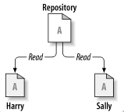
Files have to be shared among developers on a team project
Shared files can be kept in some type of Repository where they can be accessed and worked on by multiple individuals
Harry and Sally get their own respective
local Working Copies of the Master File in the Repository
Image: http://svnbook.red-bean.com/

Slide 7
What might you use for a Repository?
Would any of these work?
USB/SD drive
Private network drive
  E.g. shared “X:” drive
Cloud drive
  Google drive
  Dropbox
  iCloud
Image: http://svnbook.red-bean.com/

Slide 8
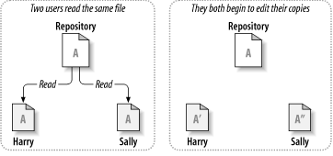
Sharing files can lead to big problems…
Adds some method
Modifies some other method
Image: http://svnbook.red-bean.com/

Slide 9
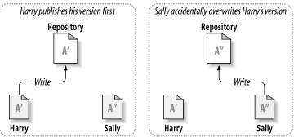
The problem to avoid:
Harry’s changes are still held locally…
Image: http://svnbook.red-bean.com/

Slide 10
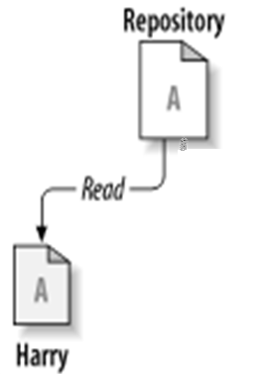
Harry’s changes are lost
‘’
Harry’s local file gets overwritten with
Sally’s latest changes.
‘’
Image: http://svnbook.red-bean.com/

Slide 11
The Issue: Effective management of software artifacts, especially code
Some acronyms:
SCM – Source Code Management
RCS – Revision Control System
VCS – Version Control System
VC – Version Control
DVCS - Distributed Version Control Systems
Notes:
My main point on this slide is that there are many acronyms for version control systems.
I removed SCCM because I haven’t seen that acronym used that often.
This page uses both RCS and SCM interchangeably:
https://dwheeler.com/essays/scm.html

Slide 12
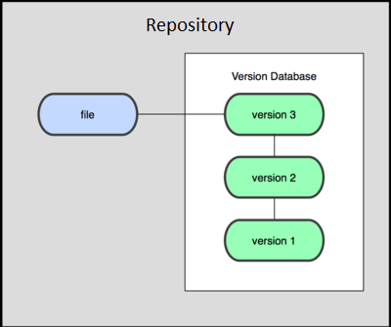
Revision/Version History might help
…but USB/SD, private network drives do not maintain revision history
Cloud drives (e.g. Google Drive, Dropbox, iCould/Time Machine) maintain a (limited) history of the various revisions of a file
  Google Drive: keeps last 100 revisions or last 30 days
    Supported in “Classic” mode only – going away?
IF you detect a collision, you can manually merge the differences and resynchronize your work
  Might be workable for two people – what about 5 or 10?

Slide 13
Any other disadvantages to
Google Drive/Dropbox/Box
Security?
Support (bug fixes and new features)?
Ownership of stored information?
Cost?
Ease of Use?
Acceptance?

Slide 14
History
SCCS, 1972 (IBM)
RCS, 1982 (Unix)
  SourceSafe 1995 (Microsoft)
CVS, 1986 (multi-platform)
SVN, 2000 (multi-platform)
Git and Mercurial, 2005 (multi-platform)
The way these work has changed over the years

Slide 15
Features of version control systems
All changes to a file are tracked
  Version histories show who, what, when
Changes can be reverted (rewound to any earlier version)
Changes between revisions are easy to identify

Slide 16
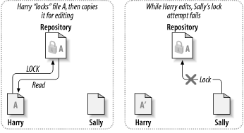
The Lock-Modify-Unlock solution
Early systems followed this model (RCS, SourceSafe)
Sally must wait until Harry releases the lock,
although she can retrieve a “readonly”
version of the file in the meantime.
Image: http://svnbook.red-bean.com/

Slide 17
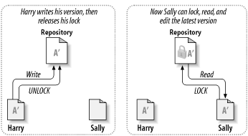
Lock-Modify-Unlock only allows a single user to edit the file at a time
Sally must continually poll the system to
see if the file has been unlocked, or Harry
needs to tell her when he unlocks it.
Image: http://svnbook.red-bean.com/

Slide 18
Lock-Modify-Unlock has certain drawbacks:
Harry has to remember to release his lock before Sally (or anyone else) can acquire the lock in order to edit
Sally has to wait for Harry to finish before editing (editing must be done sequentially)
  Harry might be adding some new methods (takes a long time)
  Harry might forget to release the lock before going home (or on vacation!)

Slide 19
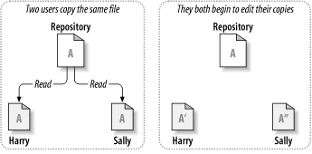
The Copy-Modify-Merge solution allows concurrent editing
CVS, SVN use this model
Harry adds new methods
Sally adds
comments
Image: http://svnbook.red-bean.com/

Slide 20
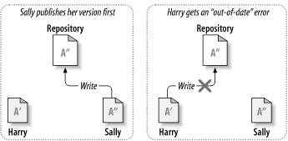
The Repository recognizes conflicts
Harry is prevented from writing
Image: http://svnbook.red-bean.com/

Slide 21
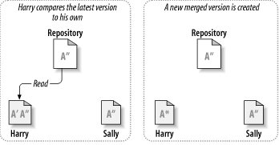
Conflicting versions of the files are merged
Conflicts are automatically resolved in many cases using robust merging algorithms.
However, manual merging is sometimes necessary and can introduce errors.
Image: http://svnbook.red-bean.com/

Slide 22
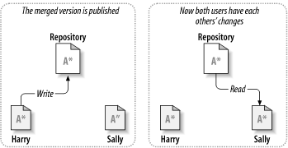
The Repository keeps both users synchronized
Image: http://svnbook.red-bean.com/

Slide 23
Copy-Modify-Merge is generally easy to use and manage
Users can work in parallel
Most of the time, concurrent changes don’t overlap
  People generally don’t edit exactly the same code simultaneously, so merging is done automatically in many cases
  Amount of time spent resolving conflicts is nearly always less than the time that would be spent waiting for a lock to be released

Slide 24

Is Lock-Modify-Unlock ever needed anymore?
When two or more people need to work on the same file, the simultaneous changes may not be mergable in all cases:
  MS Office documents
  Image documents
  Other binary files

Slide 25
Subversion’s is centralized
A repository is typically hosted on a server.
Version history is on the server, not on your local PC
If the server or network become unavailable, everyone gets stuck with the working copy they have.
Image: http://svnbook.red-bean.com/

Slide 26
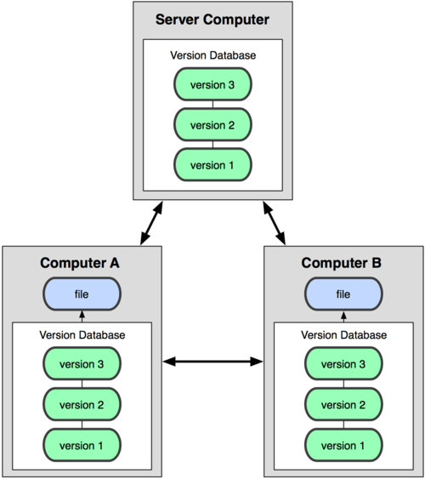
Distributed Version Control
A “remote master” repository is typically hosted on a server.
Clones of the remote repository are maintained on each user’s computer
If the server goes down, users can continue sharing code (provided they can connect over a network) by synch’ing to each others’ repositories
If the network is unavailable, users can continue reading & writing to their own local repository – synch’ing with others later
Git and Mercurial use this model
Image: http://git-scm.com/book/

Slide 27
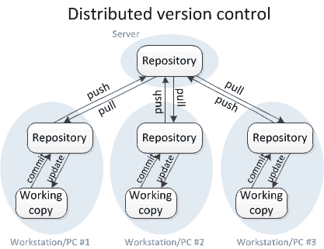
Version Control with git

Slide 28
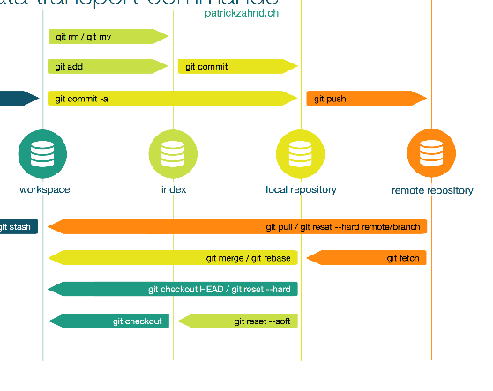
Git Commands
clone
  Copy the entire directory
status
  Shows local repo info about “staged” vs. “unstaged” files
add
  Stages a new file in the local repo (first)
commit
  Lock your changes into the local repo (second)
push
  Sync your files to shared repo (third)
pull
  Get updated files from the shared repo
Notes:
https://www.patrickzahnd.ch/uploads/git-transport-v1.png

Slide 29
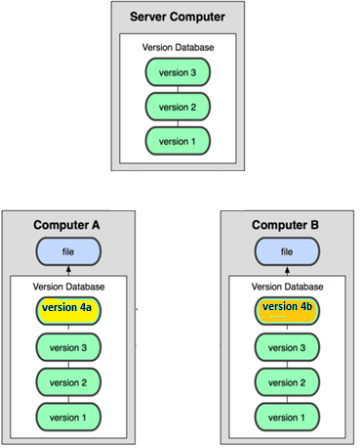
Merging in a DVCS, part 1
1. Initially, both users’ repositories
are synch’d to the remote master;
All files are identical.
2. Both users edit the same file, and their
local repositories reflect their changes

Slide 30
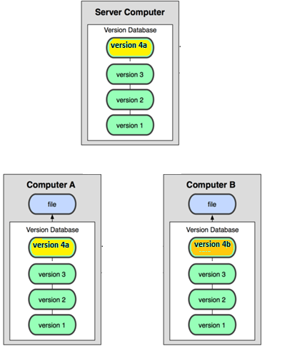
Merging in a DVCS, part 2
4. User B attempts to “push” his repository
to the remote to synch; this fails due to
User A’s earlier push. Remote does
not change.
3. User A “pushes” her repository
to the remote master to synch; this
succeeds.

Slide 31
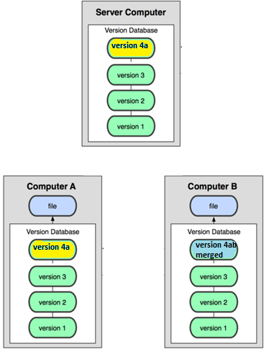
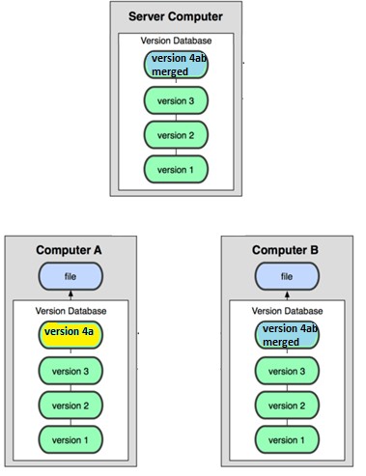
Merging in a DVCS, part 3
5. User B “pulls” User A’s updates from the remote master, merging A and B together. Merging is automatic with some exceptions.
6. User B “pushes” his repository
to the remote to synch; this now succeeds

Slide 32
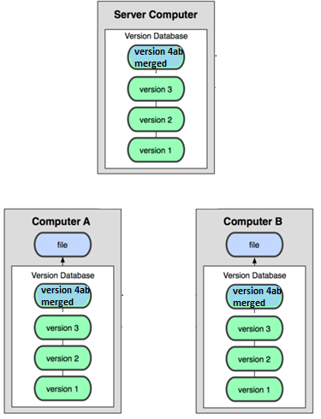
Merging in a DVCS, part 4
7. User B “pulls” from the remote, and everyone is in synch again.

Slide 33
Installing/configuring Git
You must have Git installed on your computer
  https://git-scm.com/download/win
  Default options are good
  YOU CAN SELECT YOUR DEFAULT EDITOR – Notepad++ is a good option if you already use that. Or nano if you want a simple command line program

Slide 34
HTTPS vs SSH
You may want to set up a public/private key pair to use SSH instead of HTTPS
If you use HTTPS you will need to sign in every time you use a git command
  IntelliJ will save these settings for you, but other IDEs may not
SSH is a more reliable, long term solution
  Please read this!
  http://jr0cket.co.uk/2016/05/ssh-or-https-that-is-the-github-question.html
  https://faculty-web.msoe.edu/yoder/se2030/Git#ssh

Slide 35
Git Commands
clone
  Copy the entire directory
status
  Shows local repo info about “staged” “unstaged” “untracked” files
add
  Stages a new file in the local repo (first)
commit
  Lock your changes into the local repo (second)
push
  Sync your files to shared repo (third)
pull
  Get updated files from the shared repo
Notes:
https://www.patrickzahnd.ch/uploads/git-transport-v1.png

Slide 36
Steps to git started
Sign up at bitbucket.org
  Look for my invite…
Install git
  https://faculty-web.msoe.edu/hornick/Courses/se2030/SDL-InstallingtheGitclient-150916-1010-2.pdf
Create an IntelliJ Project
Initialize the git repo (only 1 person from a team)
  git init
  git remote add origin https://yourname@bitbucket.org/se2030riley/wc#.git
  git add .
  git commit –m “First commit”
  git push origin master

Slide 37
Lets try this together
Make a change, push the change
Pull changes from others
What is happening???
  Merge conflicts!

Slide 38
Further Considerations (cont.)
Make sure to UPDATE REGULARLY
  otherwise you will have lots of conflicts
  Do a “pull” every time you turn on your machine to work!
GIT will not help you if you do not COMMIT REGULARLY
  Do a “push” any time you make any working changes

Slide 39
WARNING
You should not git add, commit, or push sensitive information to a
remote repository. Sensitive information can include, but is not limited to:
Passwords
SSH keys
AWS access keys
API keys
Credit card numbers
PIN numbers
Use .gitignore!!!

Slide 40
Git Ignore
A .gitignore file in the root directory of your project specifies which files to skip
What additionally should you ignore for IntelliJ?
  workspace.xml
  misc.xml
*.class
*.jar
*.war
*.ear

Slide 41
Further Considerations (cont.)
Deleting a file in IntelliJ and then pushing will remove the file from the current repo push
  It will NOT remove it from the history
  Deleting a directory will not remove the file!

Slide 42
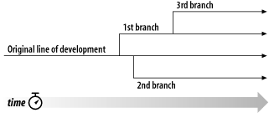
Repositories can also manage and track differences between parallel revisions of a document
Typically, a software product will undergo parallel development on different branches (e.g. for new/future features) while primary development takes place on the main (master) branch
More on this later…
Image: http://svnbook.red-bean.com/

Slide 43
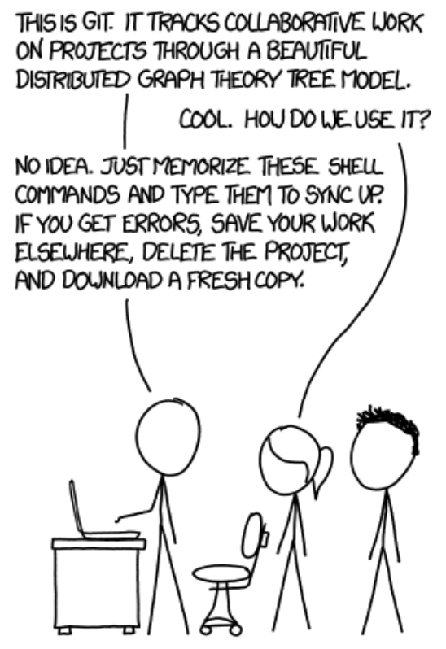
Credit: XKCD

Slide 44
Other resources
https://www.youtube.com/watch?v=DR7MLaAKcUk
https://www.udacity.com/course/how-to-use-git-and-github--ud775
https://www.youtube.com/watch?v=0fKg7e37bQE

Slide 45
