Slide 1
Advanced Version Control
Notes:
This is a real git graph from an MSOE SE SDL team (a junior-level year-long project class). The graph is from the /-/network/master page within their gitlab project.

Slide 2
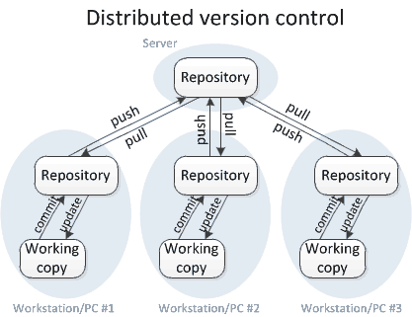
Version Control with git - Recall

Slide 3
Without Branching - Scenario
All team members push to master
Susan is updating the backend
Will take weeks
Stable when complete
Intermediate changes have unpredictable consequences elsewhere
John is making changes to the frontend
Sees side effects caused by Susan’s pushes
Thinks his code caused the changes

Slide 4
Without Branching - Scenario
Tempting solution
Don’t push to the remote repo until all changes are complete
Changes only exist locally during development
One hard drive error away from losing weeks of work!
If there are 10+ developers with different tasks on the same codebase?
Complex interactions between modules can multiply issues

Slide 5
Without Branching – Worse Scenario
Someone pushes code with errors
Code breaks
Who broke it?
Everyone’s workflow halts and the search begins
It happens
All code functions locally
ex: A function header is changed

Slide 6
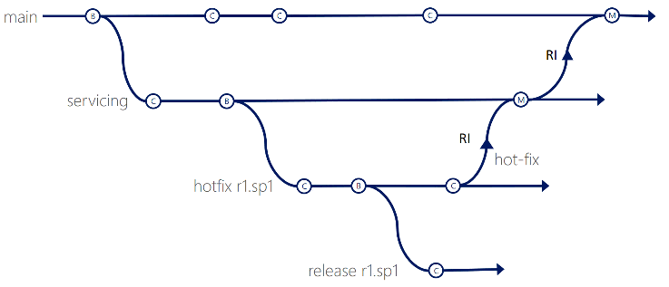
Branching
New commits are only added to the current branch
Can implement experimental code without affecting others
When the life of the branch is over
Merge it into the primary codebase
Branching is crucial on large teams

Slide 7
So far, you have used only a single branch (master) for synchronizing code
Synchronizing frequently-changing code requires merging
Merge conflicts result when the same code is simultaneously modified by >1 developer
EXAMPLES???
git push results in errors if someone else worked on the same code and modified/pushed it before you did.
Merge conflicts can often be resolved automatically if the code modifications are sufficiently separated
git pull automatically merges modifications when possible
Merge conflicts sometimes need manual resolution
git pull fails to resolve the conflict, and you must manually edit the file(s) containing the conflict indicators (<<<, >>>)
git commit stores your manually-merged file(s)
git push uploads the file(s) to the remote branch

Slide 8
The master branch should only be used for maintaining production-ready code
Code modified or created during a Sprint should be maintained on separate branches
A second standard branch – often named “dev” is typically used to maintain code that is being actively worked on
At the beginning of a phase of development, the dev branch is identical to master
During development, the dev branch maintains the evolving code
After a feature has been tested, the dev branch contains the completed code.
The dev branch is then merged into the master branch, and the process repeats
Version 1
Version 2
Version 3
master
branch
merge
merge
dev
We can reduce the amount of synchronization we need to do, as well as the number of merge conflicts, by using branches.

Slide 9
There are two ways to create dev branch
Create a local dev branch and then push that branch to the remote
Create a remote dev branch (using the Bitbucket web interface), and then pull that branch locally
$ git branch dev
$ << Note:the command executes silently>>
$ git checkout dev # and add, commit…
$ git push -u origin <branch> #ONLY USE –u THE FIRST TIME!
$ git fetch && git checkout dev From bitbucket.org:se2800/MyRepository
* [new branch] dev -> origin/dev
Branch dev set up to track remote branch dev from origin.
Switched to a new branch dev'

Slide 10
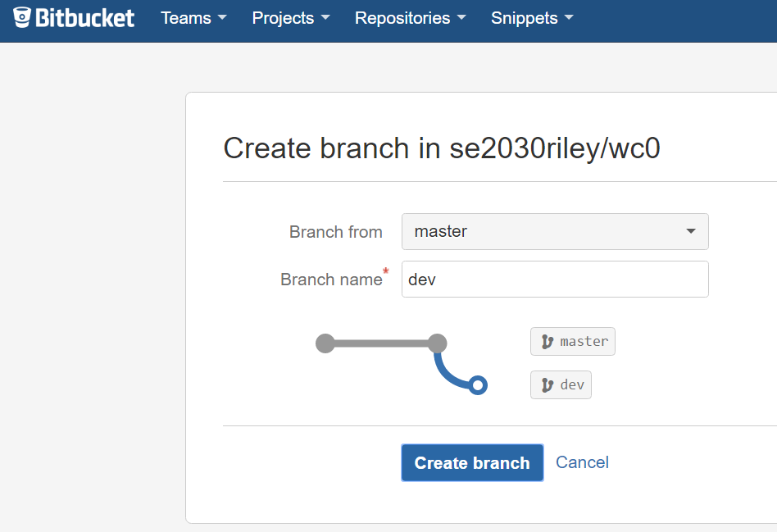
Branching
You can create a branch through the bitbucket GUI
Pull the branch using
Checkout
NOTE: If you currently have nothing to commit, and you switch branches, the code in your working directory will be replaced with the code that is in the branch you’re switching to.

Slide 11
Advanced Version Control Continued: More Branches & Git Flow
Notes:
https://nvie.com/posts/a-successful-git-branching-model/

Slide 12
Without Branching - Scenario
All team members push to master
Susan is updating the backend
Will take weeks
Stable when complete
Intermediate changes have unpredictable consequences elsewhere
John is making changes to the frontend
Sees side effects caused by Susan’s pushes
Thinks his code caused the changes

Slide 13
The master branch should only be used for maintaining production-ready code
Code modified or created during a Sprint should be maintained on separate branches
A second standard branch – often named “dev” is typically used to maintain code that is being actively worked on
At the beginning of a phase of development, the dev branch is identical to master
During development, the dev branch maintains the evolving code
After a feature has been tested, the dev branch contains the completed code.
The dev branch is then merged into the master branch, and the process repeats
Version 1
Version 2
Version 3
master
branch
merge
merge
dev
We can reduce the amount of synchronization we need to do, as well as the number of merge conflicts, by using branches.

Slide 14
Wait!
Won’t we still run into the same kind of merge conflicts if we all develop on the dev branch?

Slide 15
Yes! So teams usually use additional feature and defect branches to isolate their work
Additional branches – often named for the story or defect number, are typically used to maintain code that is being actively worked on
Usually, only one person works at fixing a defect
Often, different story features are worked on in parallel by only a few people on a team
When a story or defect is complete (and tested), its branch is merged into the dev branch.
When all stories and defects have been merged into dev, dev is merged into master
Version 1
Version 2
master
branch
merge
dev
branch
branch
merge
defectfix
merge
featureA

Slide 17
Merging back into a branch
Suppose you have finished fixing a defect on the defectfix branch
You have fully tested it and verified the fix
You have pushed your local work to the remote with a git push, and since you’re the only one working on the defectfix branch, you didn’t get any merge conflicts.
You want to merge your defect fix into the dev branch so that it later gets merged into master.
You want (need) to have your teammates review your fix and approve it before the merge can take place. You initiate a Pull Request to begin the merge process.
Version 1
master
branch
dev
branch
merge
defectfix
Pull Request here!

Slide 18
Executing a Pull Request
Select Create Pull Request. Enter a title and add all team members as reviewers. Leave the Close branch box checked.
Note that the differences between the two branches are shown in on the Overview tab.
Your teammates will get a message from Github indicating that they have code to review.
They will review the differences, and either approve or decline the request.
Once all have reviewed the request, you can click on the Merge button, and the defectfix branch will be merged into dev.
The defectfix branch, since it is no longer needed, will be automatically deleted from the remote (since you selected Close branch above).

Slide 19
Best Practices for Branching
Create a Feature branch off of Master or dev as appropriate
Master should always be kept in a ‘production-ready’ state.
Make your changes.
Commit — saves a version of your code locally
Push — sends your branch/commits to Git
Create a Pull Request when you are ready for a review
Notes:
Pull Request —> Merge Request

Slide 20
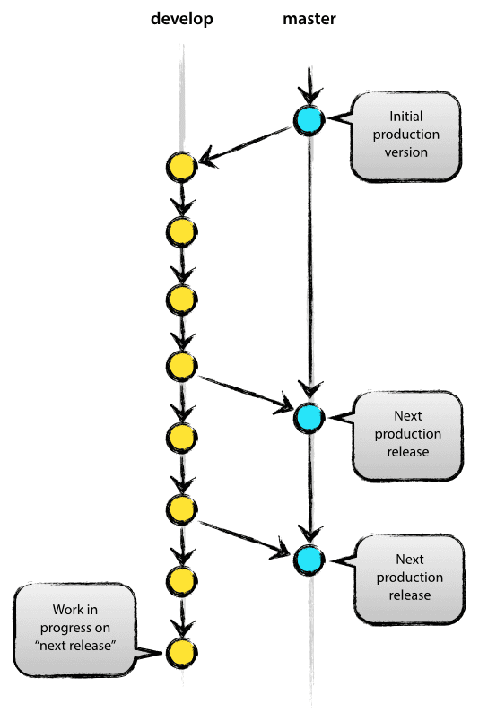
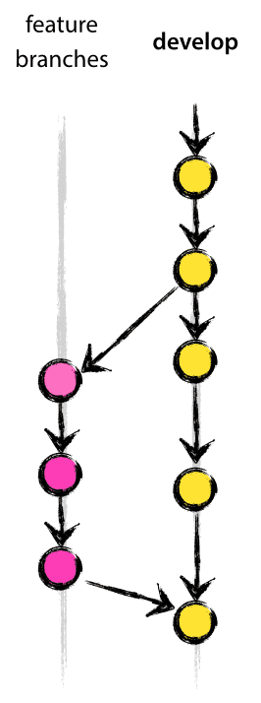
Very Large projects
feature15
Consider “Git-Flow”
Features get pushed to a Develop branch, which the tests are ran against and deployed to a testing server for QA, before being pushed to Master, and later deployed to Production.
dev
master
Notes:
Git-Flow: The collection of git branch strategies discussed in this slide-deck:
https://nvie.com/posts/a-successful-git-branching-model/
Github Flow is a simpler alternative to Git-Flow that may make more sense for webpage development:
https://guides.github.com/introduction/flow/
https://about.gitlab.com/2014/09/29/gitlab-flow/

Slide 21
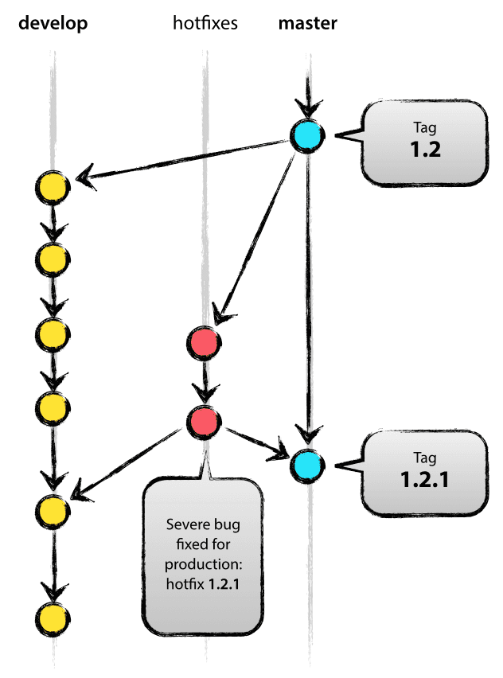
Hotfixes
Production release contains a defect
Create a hotfix branch from master
Fix the defect
merge fix into:
Next production release
Develop

Slide 23
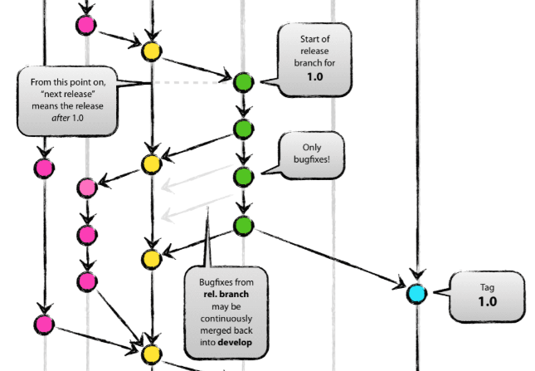
Release Branch
Branch off develop when approaching a release
No features added
Extensive testing and defect fixes
Merge all changes back to develop
When confidently stable
Merge into master as a release

Slide 24
Versioning
Tag the current state of the code
Can easily work with a previous version if needed
Use versioning on master

Slide 25
Notes:
Git-Flow: The collection of git branch strategies discussed in this slide-deck and illustrated on this slide:
https://nvie.com/posts/a-successful-git-branching-model/
Github Flow is a simpler alternative to Git-Flow that may make more sense for webpage development:
https://guides.github.com/introduction/flow/
https://about.gitlab.com/2014/09/29/gitlab-flow/

Slide 26
Tradeoffs
Parallel branches don’t interfere with each other
The longer you let branches run in parallel, the harder it is to merge!
Git may not detect that the same edit was made on both branches – so the “hotfix” strategy may not work as well in practice as the figure suggests
Notes:
Illustrates a “Common ancestor”
https://www.git-scm.com/book/ms/v2/Git-Branching-Basic-Branching-and-Merging
Merging a hotfix to multiple branches is not so simple:
https://stackoverflow.com/questions/10761348/git-merging-hotfix-to-multiple-branches
And similarly: “Wait...why is he merging his local branch into both v1.0 and development? That right there has a smell to me”
https://stackoverflow.com/questions/50466444/git-how-to-update-branch-made-by-merge-base
A special command to find a common ancestor: (I don’t know how this relates to standard git merge commands)
https://git-scm.com/docs/git-merge-base
I cannot find good discussion of git merge-base online:
https://www.quora.com/What-is-git-merge-base?share=1
Files available during a merge conflict resolution:
https://stackoverflow.com/questions/20381677/in-a-git-merge-conflict-what-are-the-backup-base-local-and-remote-files-that

Slide 27
Perspective
Windows development uses Git! (as of 2017)
65 repositories, 4,400 active branches
There are approximately 8500 commits per day
1760 builds per day!
200 pull requests to the master branch per day (500 engineers)
300GB repo managed with VFS for Git
https://arstechnica.com/information-technology/2017/05/90-of-windows-devs-now-using-git-creating-1760-windows-builds-per-day/
https://docs.microsoft.com/en-us/azure/devops/learn/devops-at-microsoft/use-git-microsoft
https://arstechnica.com/information-technology/2017/02/microsoft-hosts-the-windows-source-in-a-monstrous-300gb-git-repository/
Notes:
No new articles on this subject in April 2020.

