Slide 1
SE3910 – Real Time Systems
Thread Priorities
Slide Style & Content: Dr. Schilling
More Content: Dr. Yoder

Slide 2
Objectives
Explain how to set thread priority in Java.
Construct code which sets thread priority in Java.
Explain how to set the thread priorities in POSIX
Construct code which uses POSIX thread priorities to manage execution
Explain how one sets thread priorities using C++11 threads.

Slide 3
Threading – pthreads (review)
Java | Pthreads
java.lang.Thread | #include <pthread.h>
No external jar needed | link with -pthread
Thread t = new Thread(r) t.start(); | pthread_create(t,r,sr,a)
interface Runnable { void run(); } | Parameter: void* (*sr) (void *)
t.join(); | pthread_join(*t, &p)
Object o; | pthread_mutex_init(m,null)
synchronized(o) { … } … /* Garbage coll. */ | pthread_mutex_lock(…) … pthread_mutex_destroy(…)
Notes:
View links in class

Slide 4
Threading – pthreads (updated)
Java | pthreads
Object o; o.notify(); | phread_cond_t c = PTHREAD_COND_INITIALIZER; pthread_cond_broadcast(c);
o.wait(); | pthread_cond_wait(c,m);
o.notify(); | phtread_cond_signal(c);
o.notifyAll(); | phtread_cond_broadcast(c);
Notes:
View links in class.

Slide 5
Threading – qthreads
Java | qthreads
java.lang.Thread | #include <QThread>
No external jar needed | (qmake, moc and friends take care of this)
Thread t = new Thread(r) t.start(); | QThread *q = new QThread; moveToThread(o);
interface Runnable { void run(); } | QObject (e.g. QWidget (e.g. QMainWindow))
t.join(); | connect the QThread::finish() signal to a slot that checks if all threads are done.
Object o; | QMutex
synchronized(o) { … } … /* Garbage coll. */ | Avoid sharing memory entirely… ????

Slide 6
Looks useful if you are into Qt slots/signals == events
“A QThread should be used much like a regular thread instance: prepare an object (QObject) class with all your desired functionality in it. Then create a new QThread instance, push the QObject onto it using moveToThread(QThread*) of the QObject instance and call start() on the QThread instance. That’s all.”
https://mayaposch.wordpress.com/2011/11/01/how-to-really-truly-use-qthreads-the-full-explanation/
I have used this approach – this is what the example QtPrimeApp (or something like that) does

Slide 7
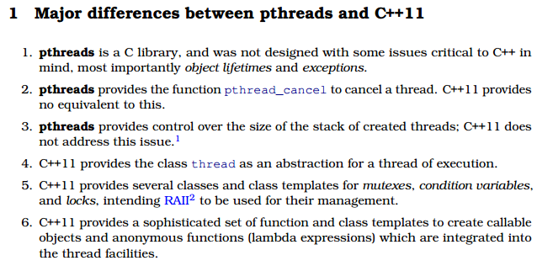
C++11 Threads
http://indico.cern.ch/event/199138/session/6/contribution/20/material/paper/0.pdf

Slide 8
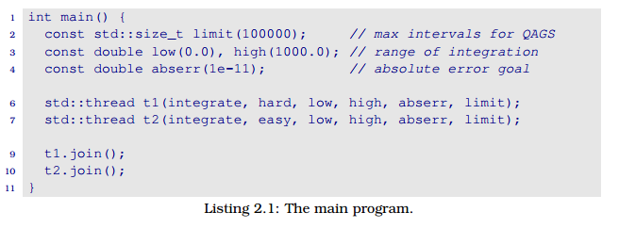
C++11 Threads

Slide 9
The integration thread

Slide 10
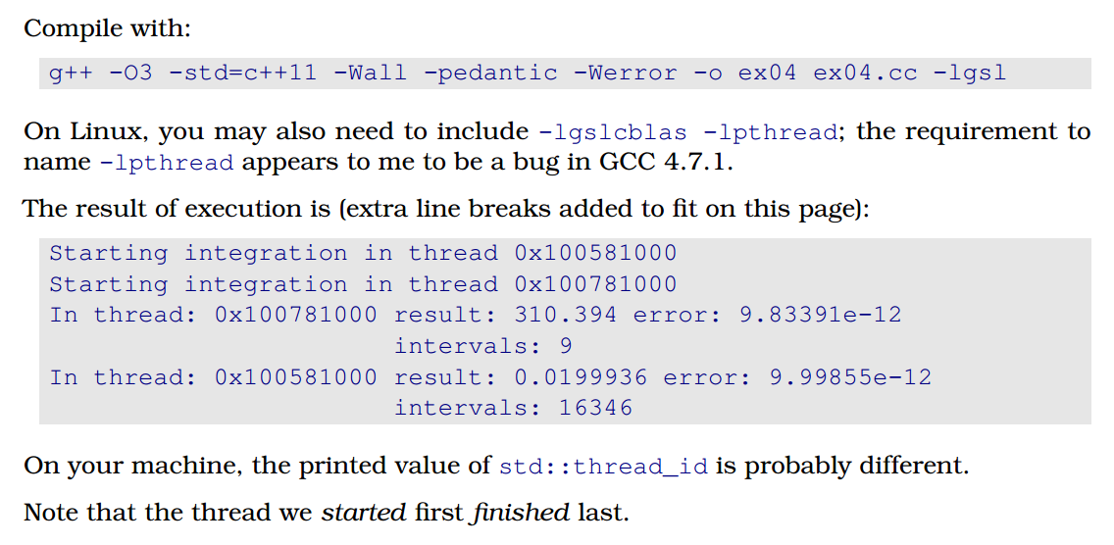
Results

Slide 11
Java Threads
How do you set the thread priority in Java?

Slide 12
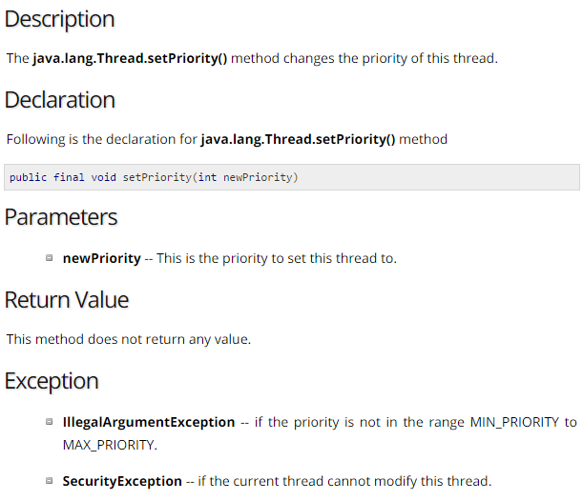

Slide 13
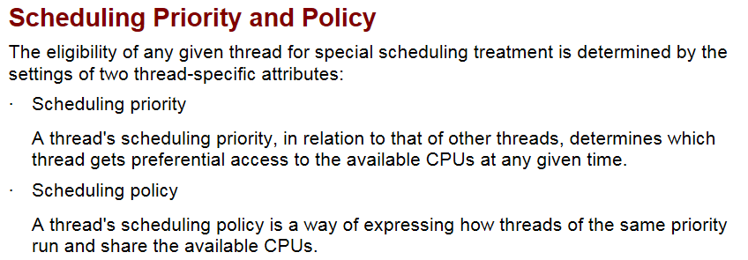
Pthreads Priority Scheduling

Slide 14
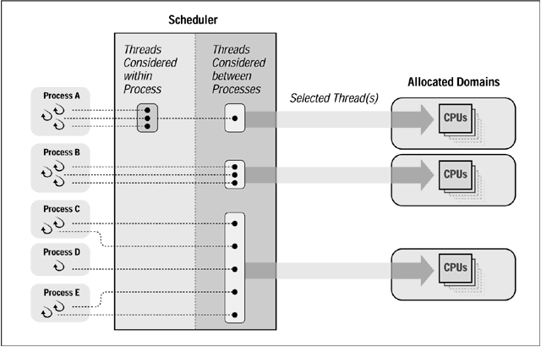
Pthread Affinity

Slide 15
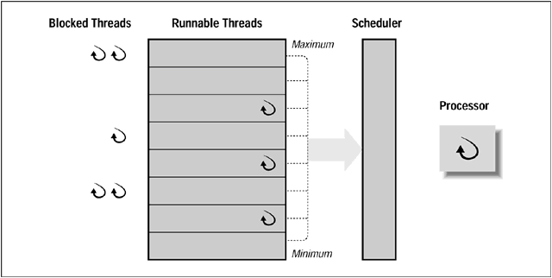
Pthread Priority Queues

Slide 16
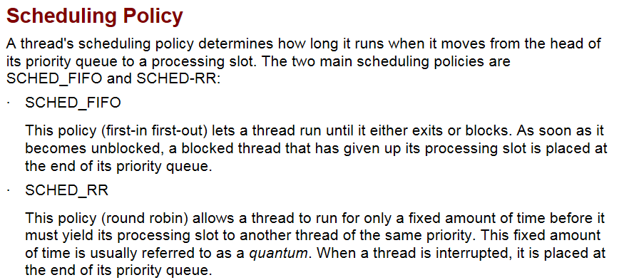
Scheduling Policy

Slide 17
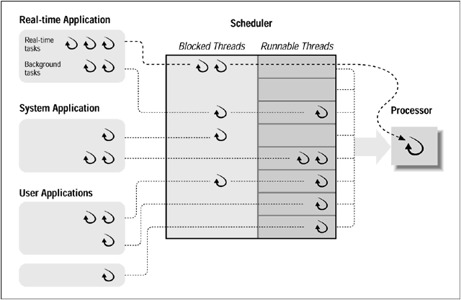
Scheduler

Slide 18
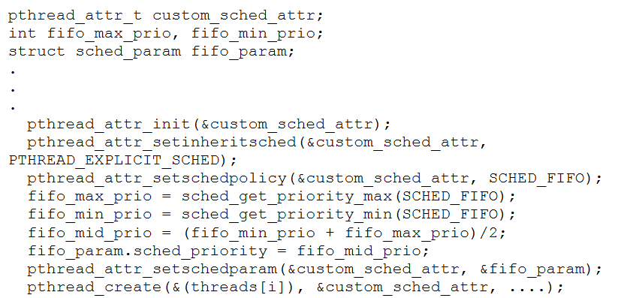
Setting attributes

Slide 19
Pthread Inheritance

Slide 20
Example

