Slide 1
SE3910 Week 10, Class 3
Today
Class Climate Surveys - Muddiest Point of the quarter? Clearest Point of the Quarter?
Review for quarter - Muddiest Point of the quarter? Clearest Point of the Quarter?
Overview of course
Practice Exercises from quarter
Spring 2017: Final Exam:
Spring 2017: Thursday 2-4pm L-306
Notes:
Full agenda:
Return Exam
Questions about lab due tomorrow in class?
Threads: Locking on null object
Threads: invokeLater
Threads: The squares example
Decorator Class Diagram
More on Java IO
Class diagrams
Design Principles
in the patterns we’ve seen so far
Compare with alternatives
Decorator vs. array approach suggested in class
Non-decorator array – decorator can be added on without modifying the original hierarchy
Decorator has “before-after” and possibly other combinatorial control that would be hard-coded in array
[Show “screenshot” of discussion from class? Or just re-type?]
Strategy vs. Decorator class diagrams side-by-side
Structural difference (inheritance optional in Strategy pattern?)
Decorator vs. “Strategy” array
Perhaps next:
Coding Starbuzz coffee (?)
Add real patterns
ArrayList – null-checking
Java I/O: Students do coding examples
http://stackoverflow.com/questions/9358821/should-i-extend-arraylist-to-add-attributes-that-isnt-null

Slide 2
What is/was SE3910 about?
Embedded Systems
Terminology
Electronics and Interfacing
Low-level I/O (simple digital input and output)
Real-Time Systems
Terminology
Meeting deadlines
Predicting and measuring latency
Predicting bandwidth, both analog and digital
Scheduling, especially RMA
Multithreading

Slide 3
Real-time Systems
It’s got to be fast… or does it?

Slide 4
Exercise
Select all that are real-time systems
Video Game
Aircraft Autopilot
Refinery Process Control
Cash Register
Smartphone
Notes:
Discussion:
Why do we pick these options?
Are there any proceses that are not real-time?
Why does the book re-define real-time systems?
What are the practical implications?

Slide 5
Exercise
Select all that are embedded systems
Video Game
Tablet
Aircraft Autopilot
Laptop
Refinery Process Control
Cash Register
Smartphone
Desk video phone
Notes:
Discussion:
What is the key difference between an embedded system and a non-embedded system?
Does this clarify our answers?

Slide 6
Circuits
What fun to wire and smoke…

Slide 7
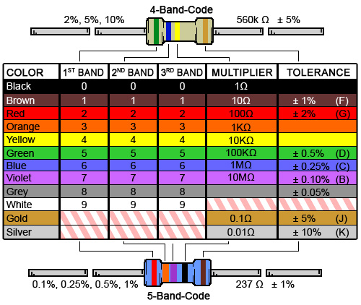
Ex: What is the resistance of this resistor?
Notes:
And what is the tolerance?

Slide 8
Ex: What is the resistance of this resistor?
Notes:
And what is the tolerance?

Slide 9
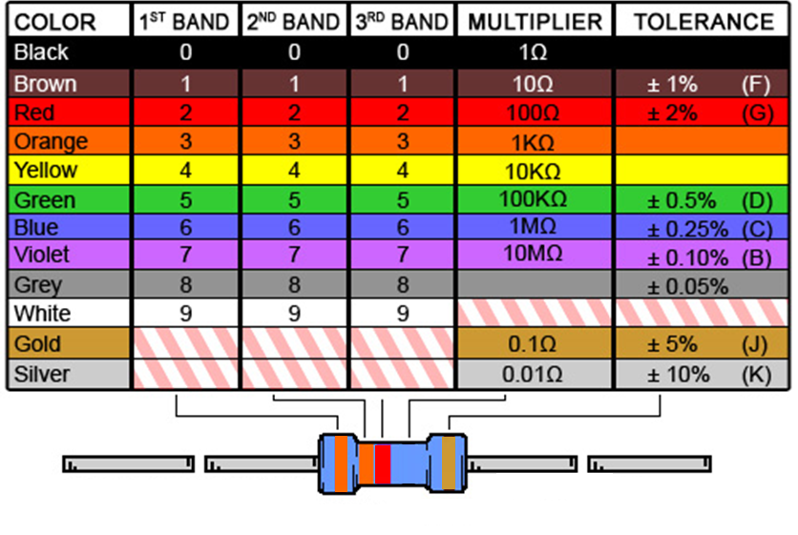
Ex: What is the resistance of this resistor?
Notes:
And what is the tolerance?

Slide 10
Ex: What is the resistance of this resistor?
Notes:
And what is the tolerance?

Slide 11
Ex: What is the resistance of this resistor?
Notes:
And what is the tolerance?

Slide 12
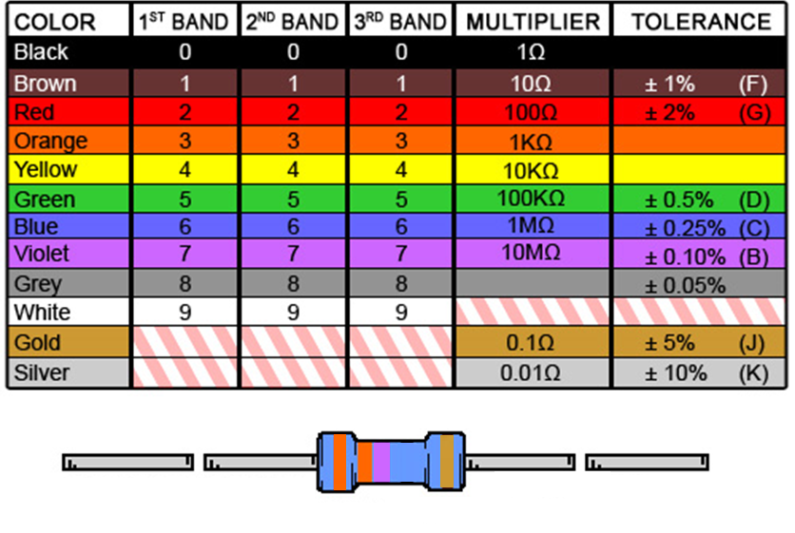
Ex: What is the resistance of this resistor?
ORANGE ORANGE VIOLET GOLD
Notes:
And what is the tolerance?

Slide 13
Ex: GPIO safety
Considering any one of the resistors on the previous slides, is it large enough to not damage a GPIO pin configured as output, if the resistor ties the output to ground?
Sourcing limit: 4mA
Sinking limit: 8mA
Voltage: 3.3 V

Slide 14
Ex: GPIO safety
Considering any one of the resistors on the previous slides, is it large enough to not damage a GPIO pin configured as output, if the resistor ties the output to 3.3V?
Sourcing limit: 4mA
Sinking limit: 8mA
Voltage: 3.3 V

Slide 15
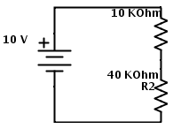
Ex: What is the voltage across R2?

Slide 16
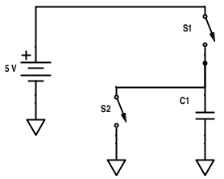
Ex: Compute voltage across C1
If S1 is closed, and S2 is opened, what is the voltage across C1?
If S2 is closed, and S1 is opened?
If both are opened?
If both are closed?

Slide 17
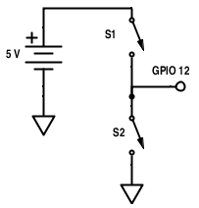
Ex: Compute voltage into GPIO input
If S1 is open and S2 is closed, compute the voltage from GPIO 12 (input) to ground.
(Assume GPIO 12 is not connected to anything)

Slide 18
Ex: What’s wrong with this simple circuit’s input?
Notes:
15q3 – 3-1
Work through making this input better

Slide 19
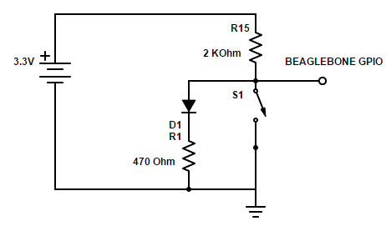
Ex: What’s wrong with this circuit? (The worst thing)

Slide 20
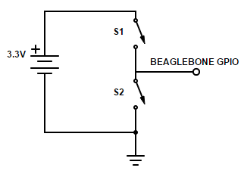
Exercise: Find all of:
Voltage from GPIO to ground if
S1 is closed
S2 is closed
Both are open
Current from source if both are closed

Slide 21
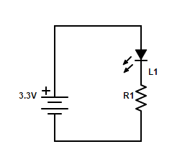
Selecting an LED resistance value
Suppose L1 is a diode with V_{d} = 1.8 V
Ex: Write a formula relating the current through L1 to R1.
Ex: Solve for R1 if we want the (max) current to be 10 mA.

Slide 22
C language
It’s like Java, only with pointers…

Slide 23
(Extra Exercise)
Why does this
6 unsigned short *pt;
7 pt = myArray[0];
Produce this?
myLib.c:7: error: data definition has no type or storage class
myLib.c:7: error: type defaults to 'int' in declaration of 'pt'
myLib.c:7: error: conflicting types for 'pt'
myLib.c:6: note: previous declaration of 'pt' was here
myLib.c:7: error: initialization makes integer from pointer without a cast
How should it be written?
Are these compile or link errors?
http://stackoverflow.com/questions/6639256/pointer-to-first-element-in-array-c

Slide 24
Exercise: Which of the following is correct?
void foo(struct bar2* b);
…
struct bar b;
And then….
foo((struct bar2*) b*)
foo((bar2*) *b)
foo((bar2*) b&)
foo((struct bar2*) &b)
Notes:
15q3 – 3-1
This problem AGAIN has an error. b is a pointer, and yet we don’t need to de-reference it. It should just be passed straight through:
foo((struct bar2*) b)

Slide 25
Exercise
How do you get a reference (pointer) to the first element in an array?
int x[5] = {1,2,3,4,5}
boolean foo(int *ip);
foo(&x);
foo(&x[0]);
foo(x);
foo(x[0]);

Slide 26
Exercise
How do you get a reference (pointer) to the second element in an array?
int x[5] = {1,2,3,4,5}
boolean foo(int *ip);
foo(&x+1);
foo(&x[0]);
foo(x+1);
foo(x[0]);
foo(&(x+1));

Slide 27
Ex: C/C++ (Review)
Why do we have both .h and .cpp file extensions for C++? Why not just have .cpp (like .java for Java classes)?
Answer these questions:
What should you put into a class’s .h file?
What should you put into a class’s .cpp file?
[Note: On next lab, use .hpp and .cpp instead of .h and .cpp]

Slide 28
Ex: C/C++
Circle the link-time errors. Box the compile-time
cannot find -lasound [NEW!!! (As of Quiz 5)]
syntax error
warning: implicit declaration of function `...'
point.m:40: error: ‘mypoint’ undeclared (first use in this function)
parse error before `...‘
collect2: ld returned 1 exit status
undefined reference to `filterText'
/usr/lib/crt1.o(.text+0x18): undefined reference to `main '

Slide 29
Quiz Practice: C/C++
Circle the link-time errors. Box the compile-time
syntax error
point.m:40: error: ‘mypoint’ undeclared (first use in this function)
collect2: ld returned 1 exit status
/usr/lib/crt1.o(.text+0x18): undefined reference to `main '
parse error before `...‘
undefined reference to `filterText'
warning: implicit declaration of function `...'

Slide 30
Other Quiz Subjects
Creating a signal from sine waves
Frequency content of a signal
Analog bandwidth
Stroboscopic effect
Why some cables can carry more data than others
Even more outcomes on outcomes page, if desired

Slide 31
ANALOG Signals
Wiggly and squiggly…

Slide 32
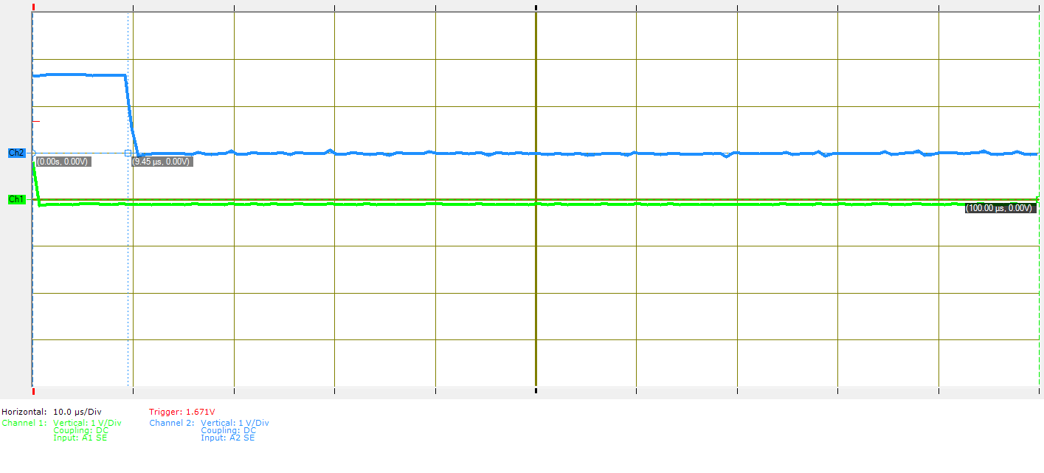
Exercise: What is the time delay between the two falling edges?
Notes:
15q3 (3-1)

Slide 33
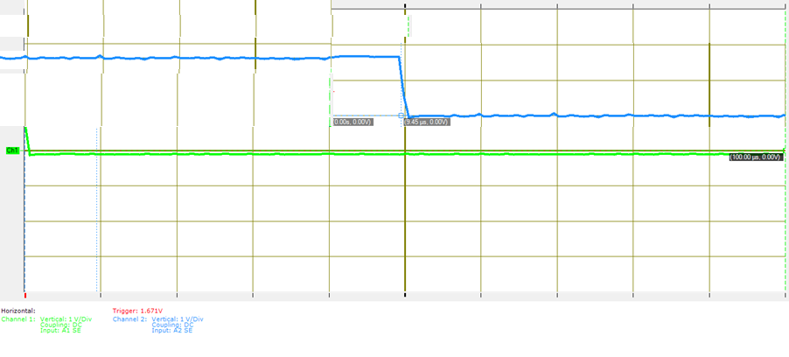
Exercise: What is the time delay between the two falling edges?
5 ms / Div

Slide 34
Exercise: What is the rise-time of this signal?
1 Volt/div
1 ms/div
0

Slide 35
Data-Rates
[Witty saying needed…]

Slide 36
TODO: Get all the noisy-analog-channel data-rates

Slide 37
SI multipliers
P = 1,000,0000,000,000,000
T = 1,000,000,000,000
G = 1,000,000,000
M = 1,000,000
K = 1,000
() = 1
m = 1/1,000
us = 1/1,000,000
ns = 1/1,000,000,000 (us = μs)

Slide 38
Binary multipliers
Pi = 1024⁵
Ti = 1024⁴
Gi = 1024³
Mi = 1024²
Ki = 1,024
() = 1

Slide 39
Ex
How many SI Kb is 4 Gibibytes (GiB)?
Note: That’s SI kilobits, not kilobytes!

Slide 40
Ex:
Suppose you are designing a real-time system, and the “remote display” design team says they can handle a data rate of 100MB/s according to their current design.
What should you ask?

Slide 41
Sampling Rate
Suppose an audio signal has a maximum frequency of 60 KHz (SI).
What is the minimum sampling rate needed to reconstruct this signal completely?
What bit-rate is needed if each sample has 65,536 possible values? (Use a binary multiplier)

Slide 42
Buffering
With 1 KB buffer, there will be ____ samples per buffer.
With a 40KHz sampling rate, the buffer must be filled every ____ milliseconds (audio deadline)
With 40KHz sampling, the maximum frequency sine-wave that can be encoded is…
[HINT: To compute: buffer size / sample size = samples per buffer
Similarly, samples per buffer / sample rate = time to empty buffer]

Slide 43
How large is an uncompressed image?
1080p
1920 x 1080
3 channels (RGB), each 8 bits
How many bytes for one image?

Slide 44
What is the uncompressed data-rate?
1080p
1920 x 1080
3 channels (RGB), each 8 bits
60 fps
What is the data rate, in Xbits per second?

Slide 45
Quiz practice: Analog to digital bandwidth
B – Digital bandwidth
H – Analog bandwidth
S – Signal power
N – Noise power
$B=Hlog2 \left(1+\frac{S}{N}\right)$
Suppose you would like to send video in a (relatively) low-frequency with a narrow bandwidth of 1 MHz
The connection is fairly noisy and you can only get 20dB SNR
What bit-rate can you achieve?
Notes:
http://www.arrl.org/files/file/Regulatory/Recommended_Practices_Version_6_5.pdf
Earlier draft:
Modern Digital TV uses the same channels as analog TV, but dynamically maps them.
But each channel is now re-used by allocating virtual “sub-channels” within the main channel that use less of the bandwidth.
This is done digitally
[And as a result, the channel width is about the same]

Slide 46
Fiber-optic Transmission
In fiber-optic transmission, signals are sent by transmitting various colors (or invisible) light down a fiber-optic channel
The colors are separated at the other end
Multiple fibers can be used
Supposing that the same bandwidth rule applies, what bandwidth can be carried by the visible spectrum? (700-400nm)
Use SNR of 4000
Hint: Convert wavelength to period/frequency
Notes:
http://physics.stackexchange.com/questions/56240/maximum-theoretical-bandwidth-of-fibre-optics
So, let's begin by exploring the best way to use our power. If we devote it to M symbols per second, each of our measurements comprise the detection of N=PMhν0 photons, thus our signal to noise ratio is SNR=NN√=PMhν0−−−−−√. By the Shannon-Hartley form of the Noisy channel coding theorem(see also here), we can therefore code our channel to get log2(1+PMhν0−−−−−√) bits of information per symbol, i.e. Mlog2(1+PMhν0−−−−−√) bits per second through our optical fibre. This is a monotonically rising function of M, so a limit on P by itself does not limit the capacity.
However, by a converse of the Nyquist-Shannon sampling theorem we can send a maximum of Bsymbols down the channel per second. This then is our greatest possible symbol rate. Hence, our overall expression for the fibre capacity in bits is:
C=Blog2(1+PBhν0−−−−−√) bits per second

Slide 47
In-class activity
What is the wavelength of a 1 MHz signal in a Cat-5 cable? (in m with an appropriate multiplier)
speed of light = 299 792 458 m / s
speed in Cat-5 is 70% of this
wavelength = time of period * velocity
What is the wavelength of a 2.5 GHz signal in a Cat-5 cable? (In m with appropriate multiplier)
Notes:
http://www.eham.net/ehamforum/smf/index.php?topic=56160.0

Slide 48
In-class Activity: What is the data rate of classic NTSC television (as digital stream)?
Store color with special scheme so only two bytes required per pixel, on average
720x480
30/1.001 fps
Follow up:
If compressed to 25MiB/s what is the compression ratio?
Notes:
[Draw out example on board]

Slide 49
In-class Activity: What digital bandwidth can be transmitted through a classic NTSC television (as digital stream)?
B – Digital bandwidth
H – Analog bandwidth
S – Signal power
N – Noise power
$B=Hlog2 \left(1+\frac{S}{N}\right)$
Suppose you would like to send video in a classic NTSC channel with a bandwidth of 6 MHz (SI)
The signal is fairly weak and you can only get 3dB SNR
What bit-rate can you achieve?
Notes:
[Draw out example on board]

Slide 50
Final Exercise
What compression ratio do you need on the video from two slides back to fit within the bandwidth from one slide back?

Slide 51
Scheduling
When will I ever get all this done?

Slide 52
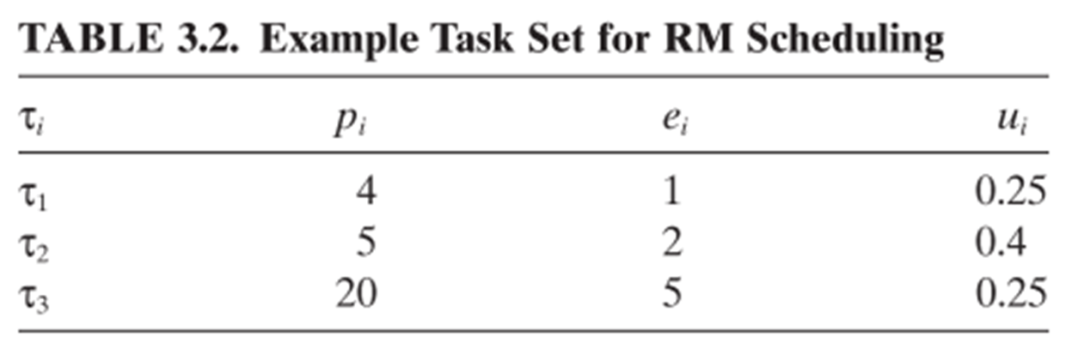
Rate-Monotonic Example
Notes:
See example soln. in text.

Slide 53
Other RMA and Scheduling questions
Does this meet the theoretical 69% bound?
Is it guaranteed to succeed?
Is it guaranteed to fail?
What simplifying assumptions do we make in RMA scheduling?
Round-robin vs. Cyclic Code Scheduling

Slide 54
Multithreading
Two hands, twice the productivity…

Slide 55
I was asked this question in an interview today…. (continued)
"When we create a thread with pthread_create() (POSIX Threads), the thread starts on its own. Why do we need to explicitly call start() in Java. What is the reason that Java doesnt start the thread when we create an instance of it."
I was blank and interviewer was short of time and eventually he couldnt explain the reason to me.
http://stackoverflow.com/questions/5269535/java-threads-vs-pthreads

Slide 56
Ex: Edit to include notify/wait to interleave these threads.
Consider this code-snippet
Queue q = …
…
synchronized(q) {
while(true) {
img = getImage();
q.offer(img);
}
}
// on another thread
synchronized(q) {
while(true) {
img = q.poll();
showImage();
}
}

Slide 57
Ex: Edit to include notify/wait to interleave these threads.
Consider this code-snippet
Queue q = …
…
synchronized(q) {
img = getImage();
while(true) {
q.offer(img);
}
}
// on another thread
synchronized(q) {
while(true) {
img = q.poll();
}
showImage();
}

Slide 58
Coding example. Exercise:
Both the Java and Qt solutions will behave poorly if I start multiple threads.
Predict how each solution will behave if I:
Click start
Click start
// what happens? (For Java? For Qt?)
Click stop
// what happens? (For Java? For Qt?)

Slide 59
More on signals/sockets in Qt
Why is it necessary to include a fifth argument when connecting the “stop” button to the “interrupt” socket on the prime worker thread?

Slide 60
Sequential Consistency
Name one of the two major things that a compiler does that invalidate the sequential consistency memory model
Why does it do these things?
Notes:
(8-3), extra slide

Slide 61
Infinite Loops and Volatile
Explain why you must declare a variable volatile if a busy-wait loop is waiting on it to change
Explain why you do not need to declare a second variable shared between the threads to be volatile, even though it is cached and thus the two threads might see different values

Slide 62
Explain the risks/benefits associated with
Sharing memory between threads
Using mutex locks
Using event queues

Slide 63
Ethics
But that’s not all, there’s more!

Slide 64
Case Studies
What do you do if you are on a project that puts human lives at risk and things are going poorly?
What can we learn from Appollo 1, 11, and Toyota?

