Slide 1
SE3910 Week 1, Class 3
Today
Continuing circuits
Beaglebone safety & I/O
Week 2 Lab
Quiz 1 – Circuits & BB safety
Lab 2 – Circuits
Complete prelab before lab
Notes:
17q3: 1-4,8-15
Full agenda:
Return Exam
Questions about lab due tomorrow in class?
Threads: Locking on null object
Threads: invokeLater
Threads: The squares example
Decorator Class Diagram
More on Java IO
Class diagrams
Design Principles
in the patterns we’ve seen so far
Compare with alternatives
Decorator vs. array approach suggested in class
Non-decorator array – decorator can be added on without modifying the original hierarchy
Decorator has “before-after” and possibly other combinatorial control that would be hard-coded in array
[Show “screenshot” of discussion from class? Or just re-type?]
Strategy vs. Decorator class diagrams side-by-side
Structural difference (inheritance optional in Strategy pattern?)
Decorator vs. “Strategy” array
Perhaps next:
Coding Starbuzz coffee (?)
Add real patterns
ArrayList – null-checking
Java I/O: Students do coding examples
http://stackoverflow.com/questions/9358821/should-i-extend-arraylist-to-add-attributes-that-isnt-null

Slide 2
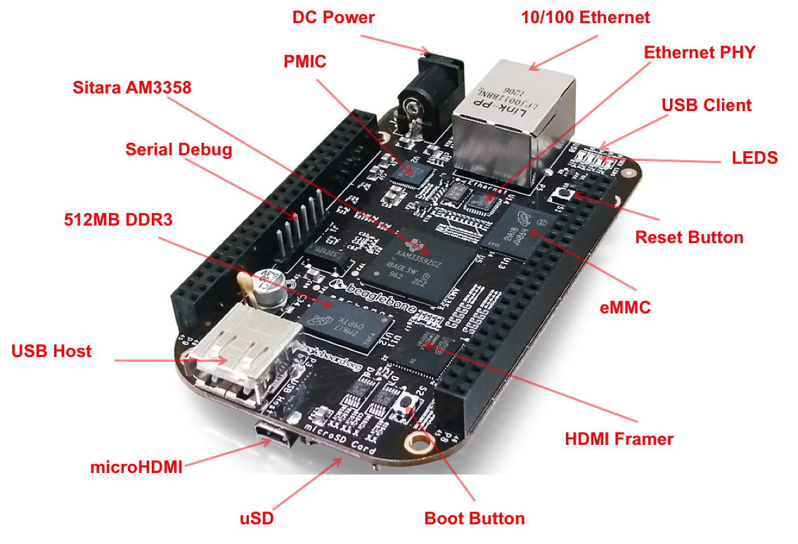
Beaglebone

Slide 3
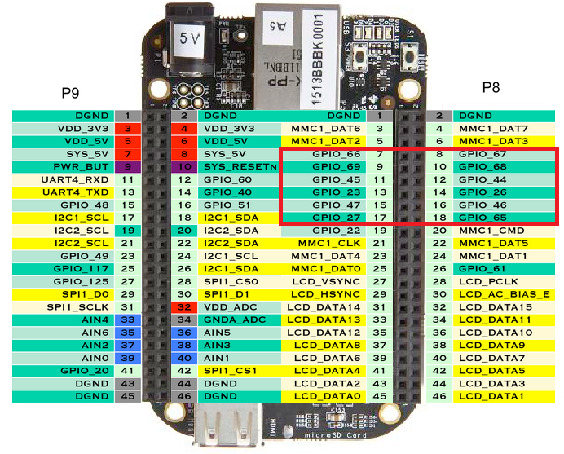
Beaglebone Black P8 and P9 headers
Our Favorites BLUE: On BASIC
PROTO CAPE

Slide 4
Finding GPIO Port
𝐸𝑥𝑝𝑜𝑟𝑡 𝑃𝑖𝑛 𝑁𝑢𝑚𝑏𝑒𝑟=
𝐺𝑃𝐼𝑂𝐶𝑜𝑛𝑡𝑟𝑜𝑙𝑙𝑒𝑟𝑁𝑢𝑚𝑏𝑒𝑟∗32+𝐺𝑃𝐼𝑂𝑃𝑖𝑛
(Useful on the basic proto cape)

Slide 5
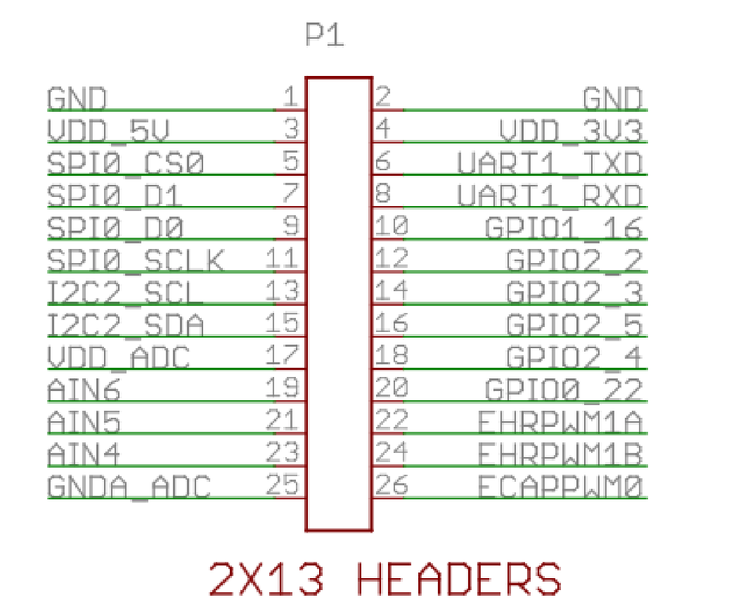
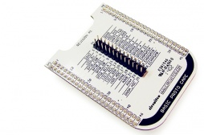
BASIC PROTO CAPE
http://elinux.org/CircuitCo:Basic_Proto_Cape

Slide 6
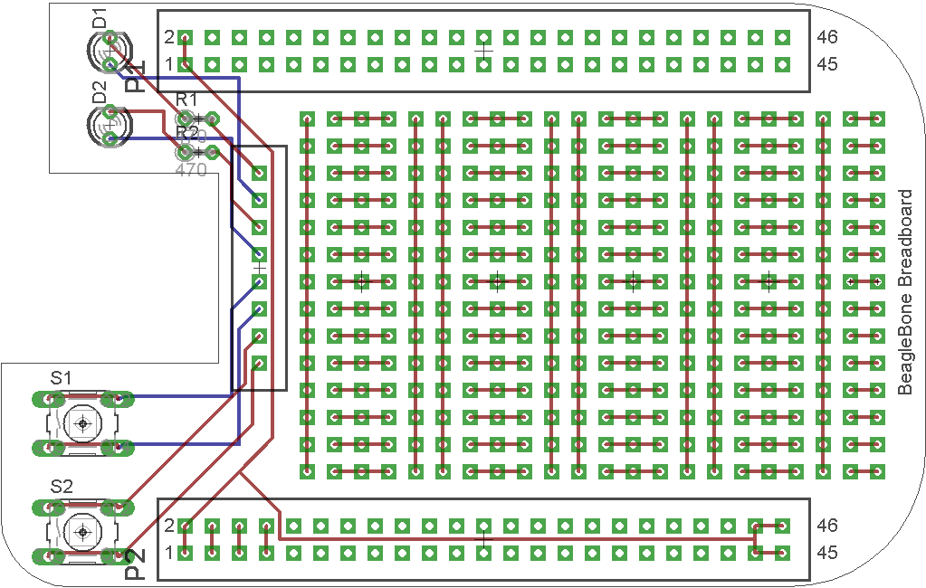
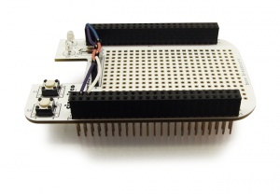
The breadboard cape

Slide 7
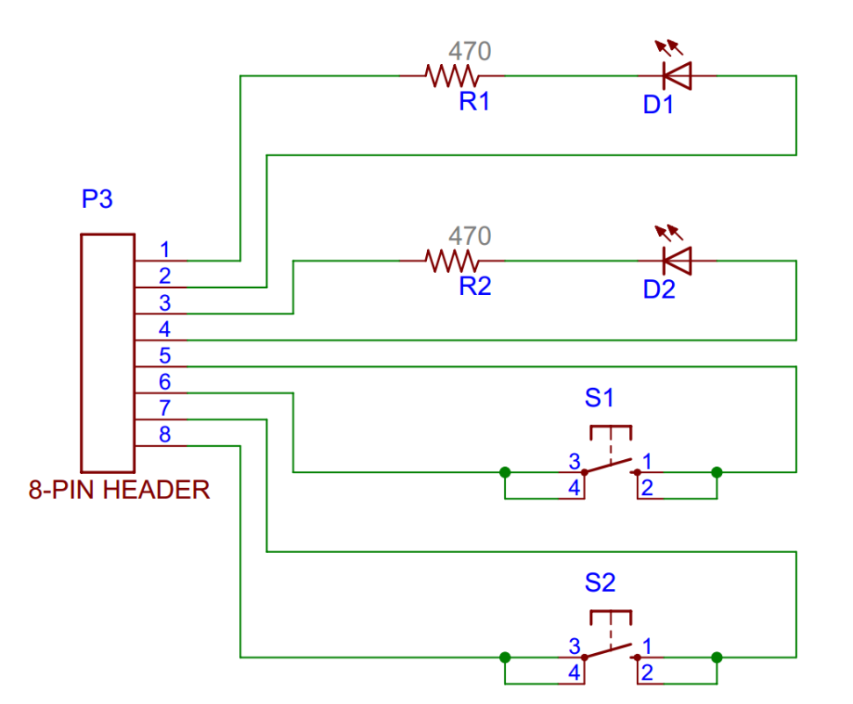
The breadboard cape
ITM | QTY | REF | PART | DESCRIPTION | DISTR | PART #
1 | 1 |  | PCB | 2-LAYER 3.4" x 2.15"
2 | 2 | P1, P2 | 2x23 HDR FE | DUAL - STRAIGHT SOCKET STRIP .025" SQ. PINS | MLE | SSHQ-123-D-08-F-LF
3 | 1 | P3 | 8 PIN HDR FE | CONN HEADER FEMALE 8 POS 0.1" GOLD | DK | PPPC081LFBN-RC
4 | 2 | S1, S2 | BUTTONS | SWITCH TACT SPST-NO .05A 24V | DK | B3F-1000
5 | 2 | D1, D2 | LEDS | LED GREEN 3MM 568NM 20mA 2.12V | DK | WP7104SGC
6 | 2 | R1, R2 | RESISTOR | RES 470 OHM 1/4W 5% CF MINI | DK | CFM14JT470R
7 | 1 | BR1 | BREADBOARD | WHT ADHSV SLDRLSS BRDBRD 170 TIE PT 1.8" x 1.37" | PLU | 1490
8 | 1 |  | JMPR WIRE KIT | 10 x 14 LNGTH .1" .2" .3" .4" .5" .6" .7" .8" .9" 1" 2" 3" 4" 5" | SQR

Slide 8
GPIO Input an Output
Take notes

Slide 9
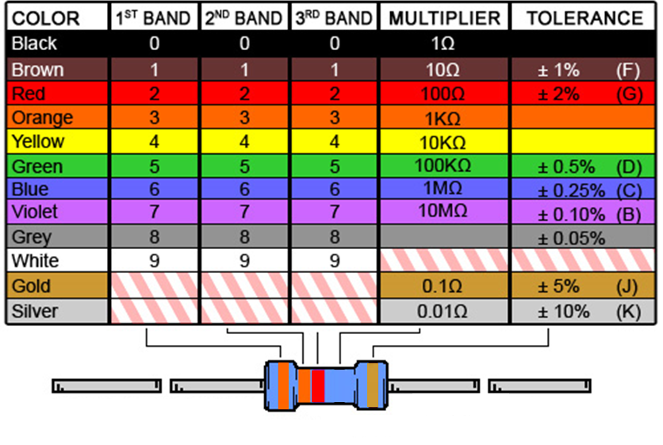
Ex: What is the resistance of this resistor?
Notes:
And what is the tolerance?

Slide 10
Ex: GPIO safety
Considering the resistor on the previous slide, is it large enough to not damage a GPIO pin configured as output, if the resistor ties the output to 3.3V?
Sourcing limit: 4mA
Sinking limit: 8mA
Voltage: 3.3 V

Slide 11
Ex: What is the resistance of this resistor?
Notes:
And what is the tolerance?

Slide 12
Ex: GPIO safety
GPIO pins:
Sourcing limit: 4mA (current flowing out of BB)
Sinking limit: 8mA (current flowing in to BB)
Voltage: 3.3 V
Considering the resistor on the previous slide, is it large enough to not damage a GPIO pin configured as output, if the resistor ties the output to ground?

Slide 13
Ex: What is the resistance of this resistor?
Notes:
And what is the tolerance?

Slide 14
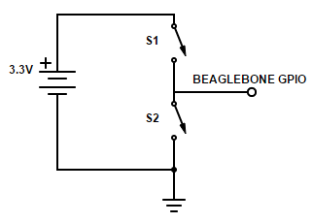
Exercise: Find all of:
Voltage from GPIO to ground if
S1 is closed
S2 is closed
Both are open
Current from source if both are closed

Slide 15
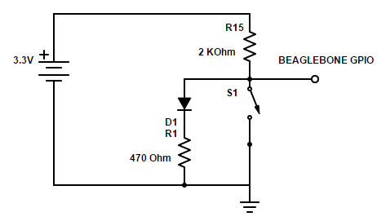
Ex: This circuit is an attempt to wire a GPIO pin as both an input and an output
What happens if GPIO is an output with a value 1 and we press the switch?

Slide 16
References
EB: Derek Malloy, Exploring Beaglebone, Wiley, 2015

Slide 17
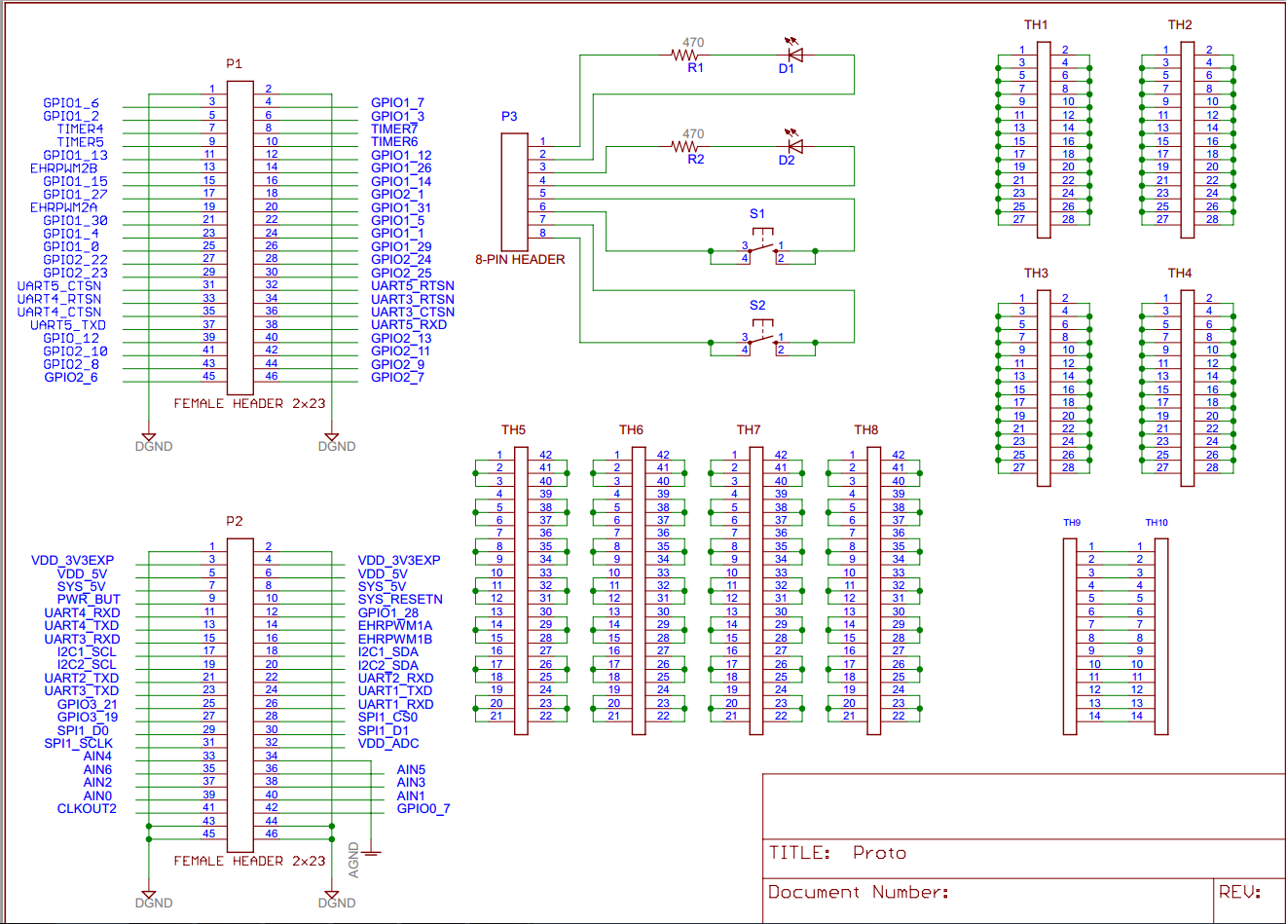
The breadboard cape

Slide 18
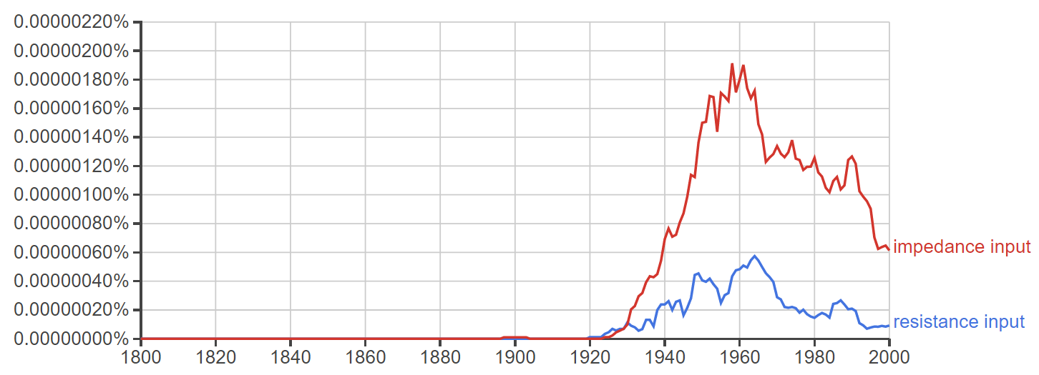
Spring 2017 Week 6, Day 1
https://books.google.com/ngrams
Resistance vs. Impedance
(high) resistance input vs. (high) impedance input

