Slide 1
SE3910
Week 3, Class 3
Today
  See other slides
  Estimating Datarates
In Lab: Quiz
  See other slides

Slide 2
Lab 3 Spring 2016 response times button-press to LED
Notes:
Note the long tails

Slide 3
Definitions for Quizzes/Exams
What is an appropriate multiplier?
What is an SI multiplier?
What is a binary multiplier?
How do you abbreviate bit and Byte?

Slide 4
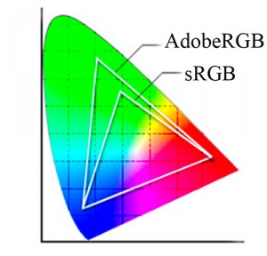
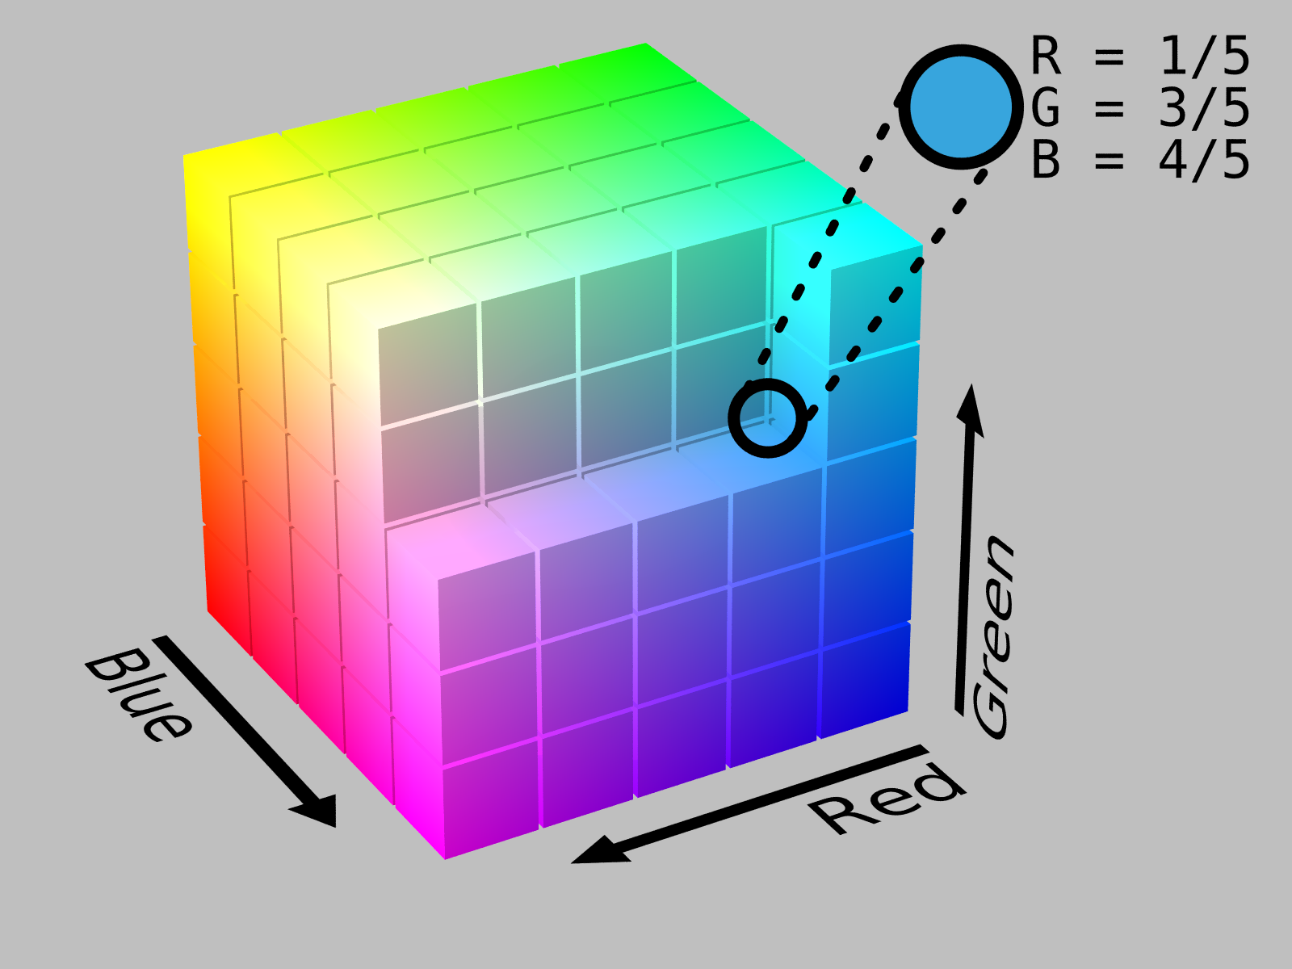
Storing Color
Only three colors needed
  Red
  Green
  Blue
Only 256 values
(0-255) for each color
Ex: How many bits?
http://en.wikipedia.org/wiki/RGB_color_space
http://thelightroomlab.com/2010/11/understanding-digital-camera-color-space-choices/

Slide 5
Storing an image

Slide 6
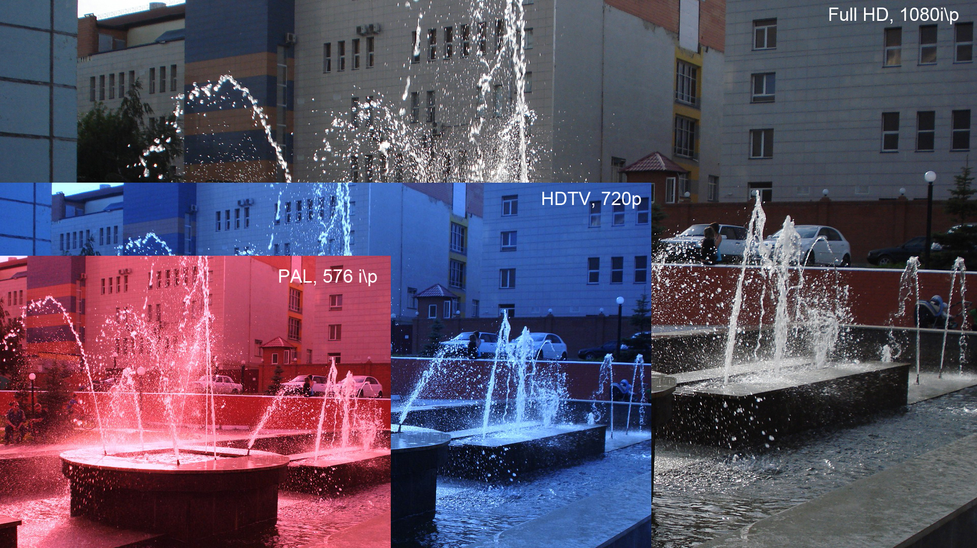
Full HD/1080p
Notes:
Explain that 1080p means the image has a resolution of 1920 by 1080
Image is sent at 60 frame per second
Each pixel has at least 24 bit color associated with it
i – interaced
p – progressive

Slide 7
How large is an uncompressed image?
1080p
  1920 x 1080
  3 channels (RGB), each 8 bits
How many bytes for one image?

Slide 8
What is the uncompressed data-rate?
1080p
  1920 x 1080
  3 channels (RGB), each 8 bits
  60 fps
What is the data rate, in Xbits per second?

Slide 9
SI Multipliers
P (SI) = 1,000,0000,000,000,000
T (SI) = 1,000,000,000,000
G (SI) = 1,000,000,000
M (SI) = 1,000,000
K (SI) = 1,000
() = 1
m = 1/1,000
us = 1/1,000,000
ns = 1/1,000,000,000 (us = μs)

Slide 10
Started Here Spring 2017, Week 5, Class 3

Slide 11
Binary Multipliers
Pebi = Pi = 1024⁵
Tebi = Ti = 1024⁴
Gibi = Gi = 1024³
Mebi = Mi = 1024²
Kibi = Ki = 1,024
() = 1

Slide 12
Abbreviating
B = Byte = 8 bits
b = bit = 0.125 Bytes
b/s = bit/second
MB (SI) = Mega Byte (SI) = 1,000,000 Bytes
Mb (SI) = Mega bit (SI) = 1,048,576 bits
Tib/s = Tebi bit / second = 1.10 T bit/s (SI)
PiB = Peta Byte = 1.13 PB (SI)
Always specify either SI or binary

Slide 13
H.262 Compression
Suppose a Full HD signal -- 1080p
  1920 x 1080
  3 channels (RGB), each 8 bits
  60 fps
H.262 compression has a target maximum data rate of 25 Mb/s. Supposing this means Mebibits/s, what is the desire compression ratio?
compression ratio = uncompressed /
compressed

Slide 14
Transmitting data
Physical Layer
  You didn’t talk too much about this in Network Protocols
  Can occur through many mediums
    Twisted Pair
    Coaxial Cable
    Fiber Optics
    Wireless

Slide 15
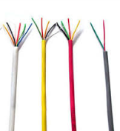
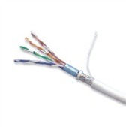

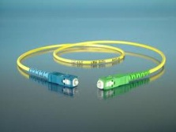
Physical cable data rates
Wiring Type | Analog Bandwidth
CAT 3 | 16MHz
CAT 5 | 100 MHz
Coaxial Cable (50 Ohm) | 1-2 GHz
Fiber Optic Fiber (Single fiber) | 100 Tbit/s
Sources: Dr. Schilling’s Slides and
http://en.wikipedia.org/wiki/Fiber-optic_communication
Notes:
Compare result with this
We got this far – working examples either again or for the first time and discussing new material.

Slide 16
Physical transmission:
Latency vs. Bandwidth
Latency – delay to go over line
Bandwidth – rate of data
Can have high latency, high bandwidth (e.g. 1TB (SI) thumb-drive sneaker-net)
Can have low latency, low bandwidth (e.g. morse code through dedicated line)
[See MATLAB example]

Slide 17
The Stroboscopic Effect
Have you ever noticed something that is in motion seem to stop?

Slide 18
The Stroboscopic Effect
(Aliasing)
http://upload.wikimedia.org/wikipedia/commons/7/77/Propeller_strobe.ogv
http://upload.wikimedia.org/wikipedia/commons/e/ef/The_wagon-wheel_effect.ogv

Slide 19
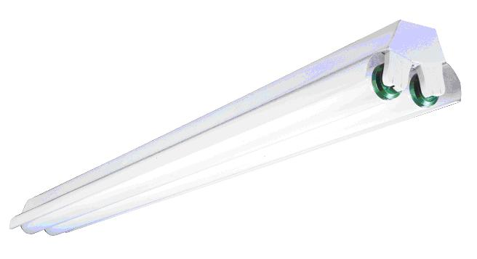
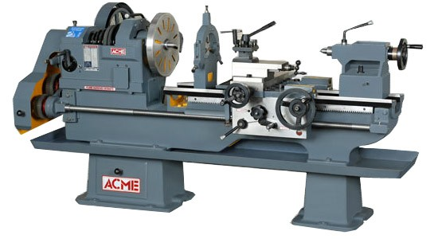
Safety
See, e.g. http://www.seasshops.ucla.edu/services/student-faculty-shop/machine-shop-rules

Slide 20
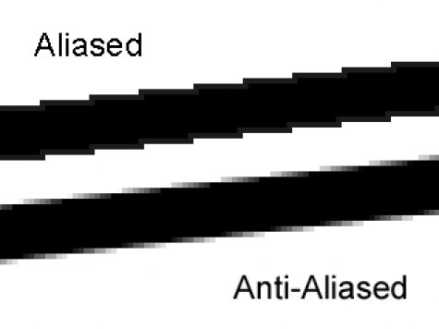
Aliasing
http://photo.stackexchange.com/questions/24512/what-is-aliasing-and-anti-aliasing

Slide 21
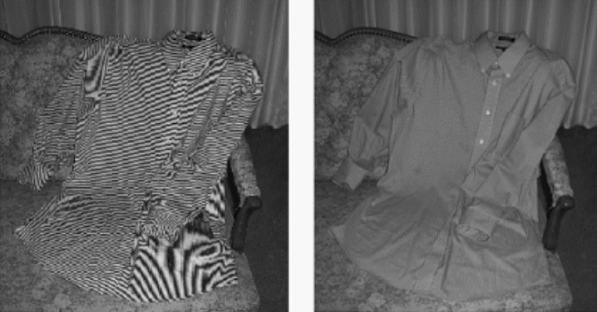
More aliasing
Single-Sensor Imaging: Methods and Applications for Digital Cameras, by Rastislav Lukac
http://www.openphotographyforums.com/forums/showthread.php?t=14988

Slide 22
Encoding audio signals digitally
How much data do we need to encode an audio signal?
[Matlab demo]
f_{sample} > 2f_{max audio frequency}

Slide 23
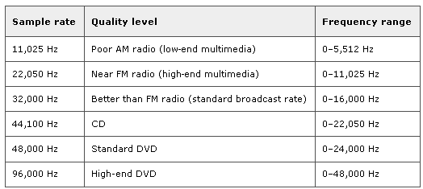
Sampling Theorem (again Nyquist)
f_{s} = 2f_{m} (f_{m} is maximum frequency of signal)
Notes:
Did not get to this.

Slide 24
Buffering
With 1 KB (SI) buffer and 16-bit samples, there will be ____ samples per buffer
What is the maximum frequency analog singal that can be encoded, if the buffer holds 1 second of sound?

Slide 25
SE3910
Week 4, Class 3
Today
  Spectral Theory
  Physical Datarate Limits
In Lab: No Quiz!

Slide 26
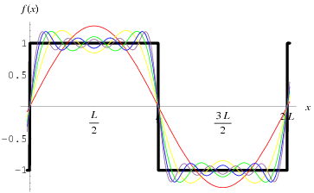
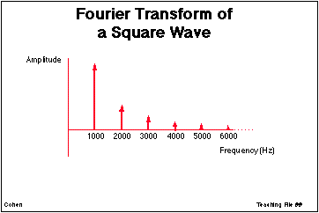
Signals as sums of sine-waves
[See Matlab demo]
http://ccn.ucla.edu/BMCweb/SharedCode/slides/SlideFiles.html
http://mathworld.wolfram.com/FourierSeriesSquareWave.html

Slide 27
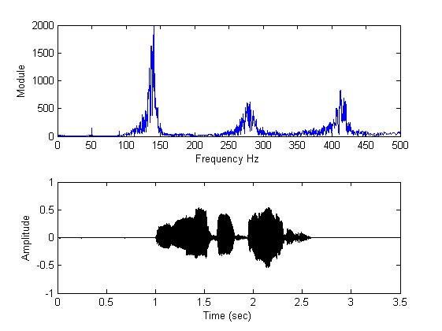
What is analog bandwidth?
Time
Freq.
http://www.mathworks.com/matlabcentral/fileexchange/22214-voice-audio-processing
Notes:
Can do this not only with audio, but also with radio waves
Square the time signal, and the area under the curve will equals the result from
squaring the Fourier transform and taking the area under it. This is Parseval’s theorem:
http://en.wikipedia.org/wiki/Parseval's_theorem
Intuitively, we can see energy in the time signal, or energy in the frequency spectrum. Same energy, different views.

Slide 28
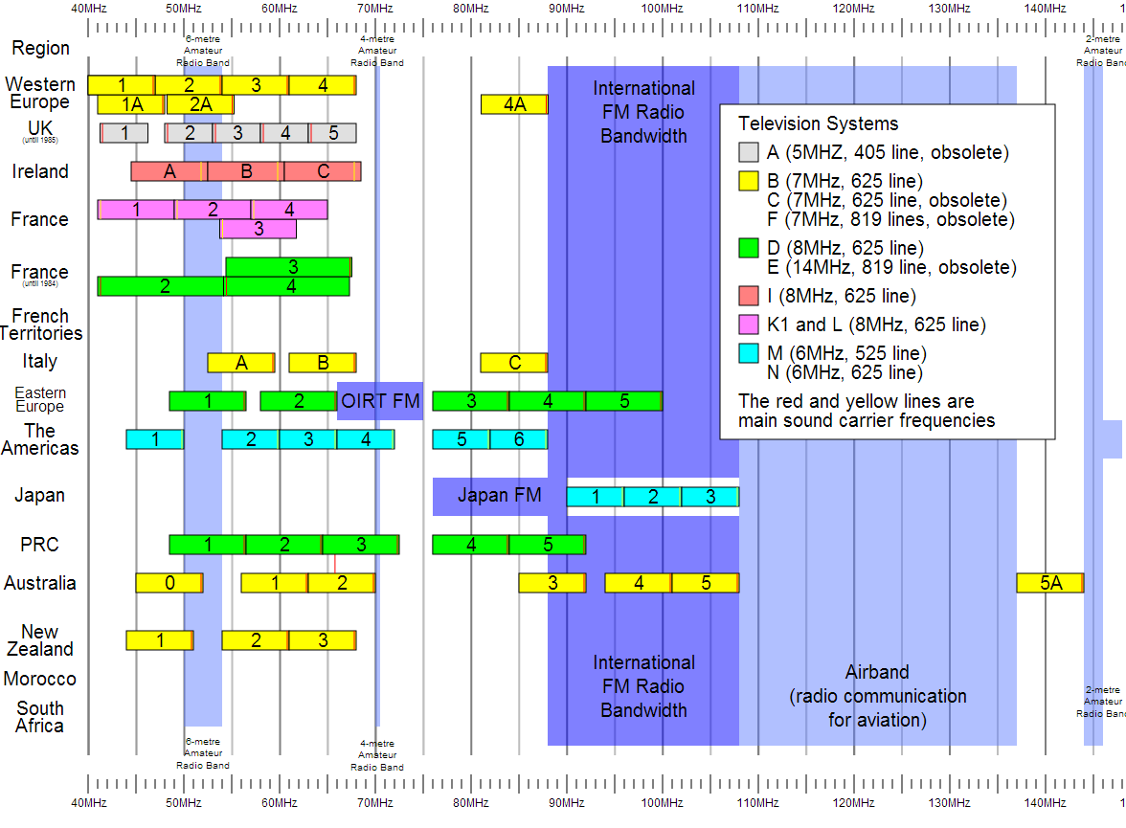
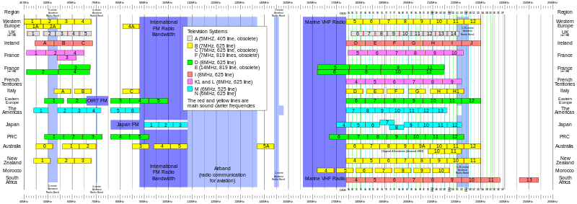
Notes:
For Digital TV:
http://transition.fcc.gov/mb/engineering/dtvmaps/
Full US allocations:
http://upload.wikimedia.org/wikipedia/commons/4/45/United_States_Frequency_Allocations_Chart_2003_-_The_Radio_Spectrum.jpg
VHF Usage (World wide)
[DEAD LINK] http://upload.wikimedia.org/wikipedia/en/c/cc/VHF_Usage.svg
https://commons.wikimedia.org/wiki/File:VHF_Usage.svg

Slide 29
Noise, Latency, and Bandwidth
If we add noise to the line
  If the “noise” is other users sending packets
    Must resend whole packet – increases latency
    Transport-level
  If the “noise” is “white noise”
    Must use more redundancy – e.g. use more time per bit
    Decreases bandwidth, but latency is the same
    Link-level

Slide 30
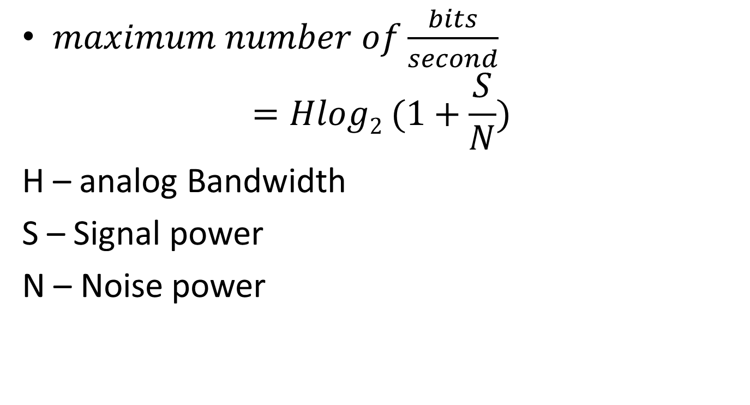
Claude Shannon –
Channel Capacity
$maximum number of\frac{bits}{second}$
$$=Hlog2 (1+\frac{S}{N})$$
H – analog Bandwidth
S – Signal power
N – Noise power

Slide 31
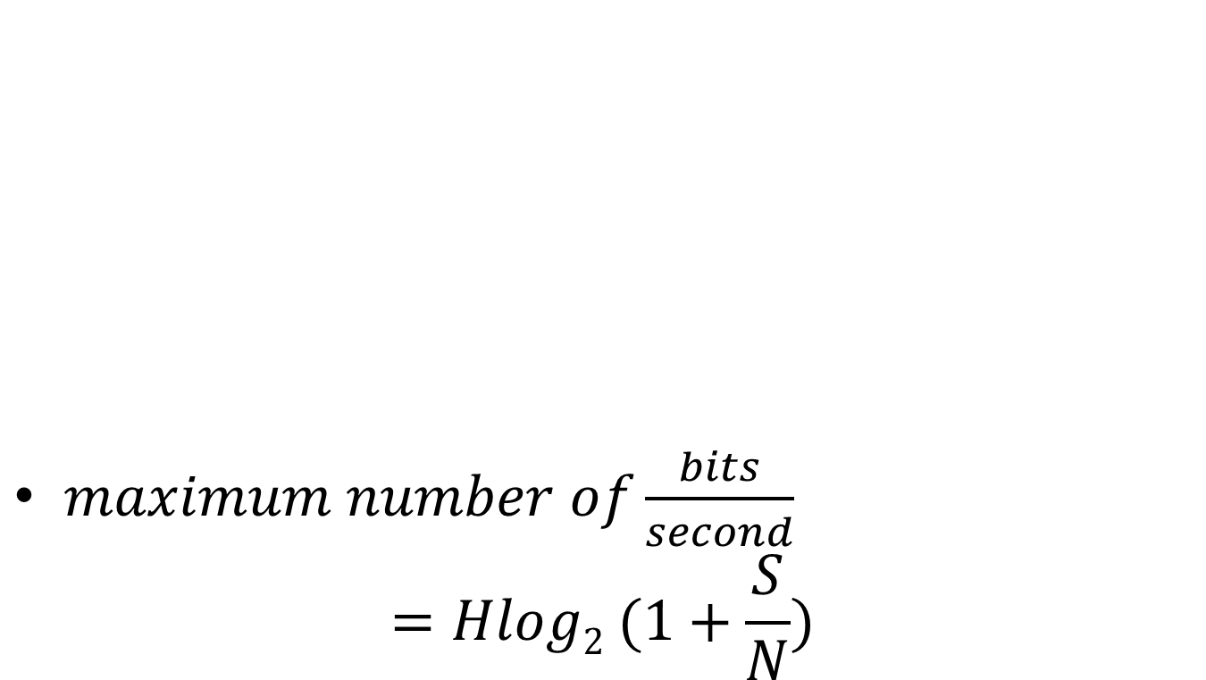
Channel capacity
$maximum number of\frac{bits}{second}$
$$=Hlog2 (1+\frac{S}{N})$$

Slide 32
In-class exercise
The old analog TV channels had a bandwidth of 6MHz
Supposing a SNR of 50 dB, what is the maximum possible bit-rate?
Notes:
For Spring 2015 (15q3):
Work through one, then give an in-class exercise for the following.

Slide 33
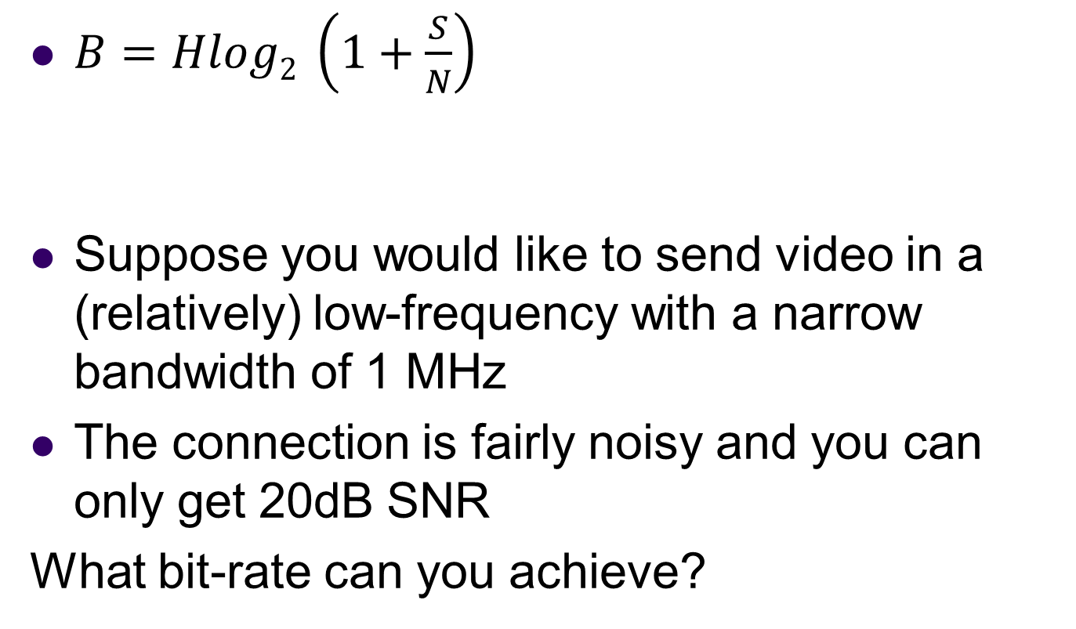
Quiz practice:
Analog to digital bandwidth
B – Digital bandwidth
H – Analog bandwidth
S – Signal power
N – Noise power
$B=Hlog2 \left(1+\frac{S}{N}\right)$
Suppose you would like to send video in a (relatively) low-frequency with a narrow bandwidth of 1 MHz
The connection is fairly noisy and you can only get 20dB SNR
What bit-rate can you achieve?
Notes:
http://www.arrl.org/files/file/Regulatory/Recommended_Practices_Version_6_5.pdf
Earlier draft:
Modern Digital TV uses the same channels as analog TV, but dynamically maps them.
But each channel is now re-used by allocating virtual “sub-channels” within the main channel that use less of the bandwidth.
This is done digitally
[And as a result, the channel width is about the same]

Slide 34
Fiber-optic Transmission
In fiber-optic transmission, signals are sent by transmitting various colors (or invisible) light down a fiber-optic channel
The colors are separated at the other end
Multiple fibers can be used
Supposing that the same bandwidth rule applies, what bandwidth can be carried by the visible spectrum? (700-400nm)
Use SNR of 4000
Hint: Convert wavelength to period/frequency
Notes:
http://physics.stackexchange.com/questions/56240/maximum-theoretical-bandwidth-of-fibre-optics
So, let's begin by exploring the best way to use our power. If we devote it to M symbols per second, each of our measurements comprise the detection of N=PMhν0 photons, thus our signal to noise ratio is SNR=NN√=PMhν0−−−−−√. By the Shannon-Hartley form of the Noisy channel coding theorem(see also here), we can therefore code our channel to get log2(1+PMhν0−−−−−√) bits of information per symbol, i.e. Mlog2(1+PMhν0−−−−−√) bits per second through our optical fibre. This is a monotonically rising function of M, so a limit on P by itself does not limit the capacity.
However, by a converse of the Nyquist-Shannon sampling theorem we can send a maximum of Bsymbols down the channel per second. This then is our greatest possible symbol rate. Hence, our overall expression for the fibre capacity in bits is:
C=Blog2(1+PBhν0−−−−−√) bits per second

Slide 35
Sprint 2017, Week 8, Class 2:
Stopped Here

Slide 36
In-class activity
What is the wavelength of a 1 MHz signal in a Cat-5 cable? (in m with an appropriate multiplier)
speed of light = 299 792 458 m / s
speed in Cat-5 is 70% of this
wavelength = time of period * velocity
What is the wavelength of a 2.5 GHz signal in a Cat-5 cable? (In m with appropriate multiplier)
Notes:
http://www.eham.net/ehamforum/smf/index.php?topic=56160.0

Slide 37
In-class Activity: What is the data rate of classic NTSC television (as digital stream)?
Store color with special scheme so only two bytes required per pixel, on average
720x480
30/1.001 fps
Follow up:
If compressed to 25MiB/s what is the compression ratio?
Notes:
[Draw out example on board]

Slide 38
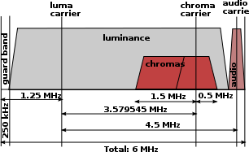
Classic NTSC channel layout
Notes:
https://en.wikipedia.org/wiki/File:Ntsc_channel.svg
https://en.wikipedia.org/wiki/NTSC#Transmission_modulation_scheme

Slide 39
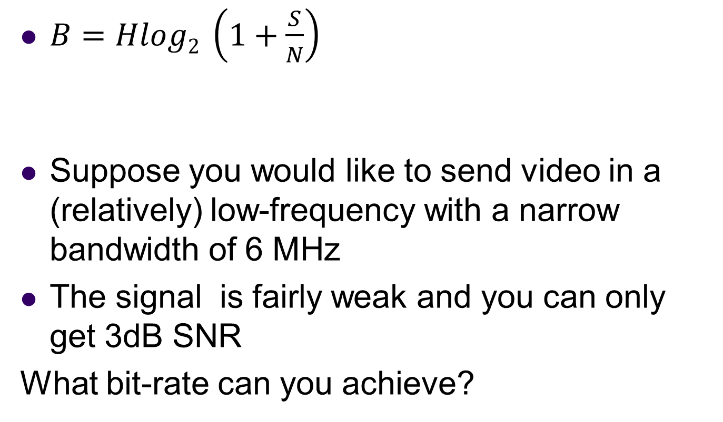
In-class Activity: What digital bandwidth can be transmitted through a classic NTSC television (as digital stream)?
B – Digital bandwidth
H – Analog bandwidth
S – Signal power
N – Noise power
$B=Hlog2 \left(1+\frac{S}{N}\right)$
Suppose you would like to send video in a (relatively) low-frequency with a narrow bandwidth of 6 MHz
The signal is fairly weak and you can only get 3dB SNR
What bit-rate can you achieve?
Notes:
[Draw out example on board]

Slide 40
Final Exercise
What compression ratio do you need on the video from two slides back to fit within the bandwidth from one slide back?

Slide 41
Stopped Here Spring 2017 Week 8, Class 3

Slide 42
Ex:
Why might you want to sample at a higher frame-rate than the 30fps?
Be as professional as possible
  Avoid flame wars
  Have technical depth to back it
  Avoid sounding technical just to be cool

Slide 43
Human eye
Recall
  As little as 13ms
Notice interruption
  As short as 16ms
Single-ms duration looks as long as
  100-400ms
10ms green followed by 10ms red
  May appear as single yellow stimulus

Slide 44
Ex:
Why might you want to sample at a higher frame-rate than the 30fps?
Be as professional as possible
  Avoid flame wars
  Have technical depth to back it
  Avoid sounding technical just to be cool

Slide 45
Ex:
What are two ways we can avoid the stroboscopic effect in a video game simulation of a rotating wheel?

